Slide 1
AVNRT project: recap of results
January 2025
Andrea Corrado

Slide 2
Outline
Problem statement: recap
Feature extraction
Envelope features
Template matching features
Short time Fourier transformation features
Classification
Feature correlation analysis
Knowledge based approach
Machine learning approach: tree - MLR - SVM
Best model evaluation
Conclusions

Slide 3
Outline
Problem statement: recap
Feature extraction
Envelope features
Template matching features
Short time Fourier transformation features
Classification
Feature correlation analysis
Knowledge based approach
Machine learning approach: tree - MLR - SVM
Best model evaluation
Conclusions

Slide 4
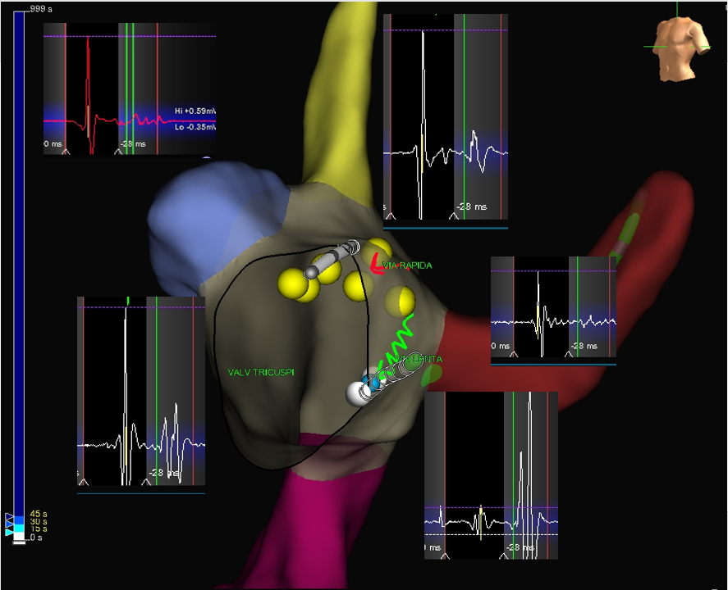
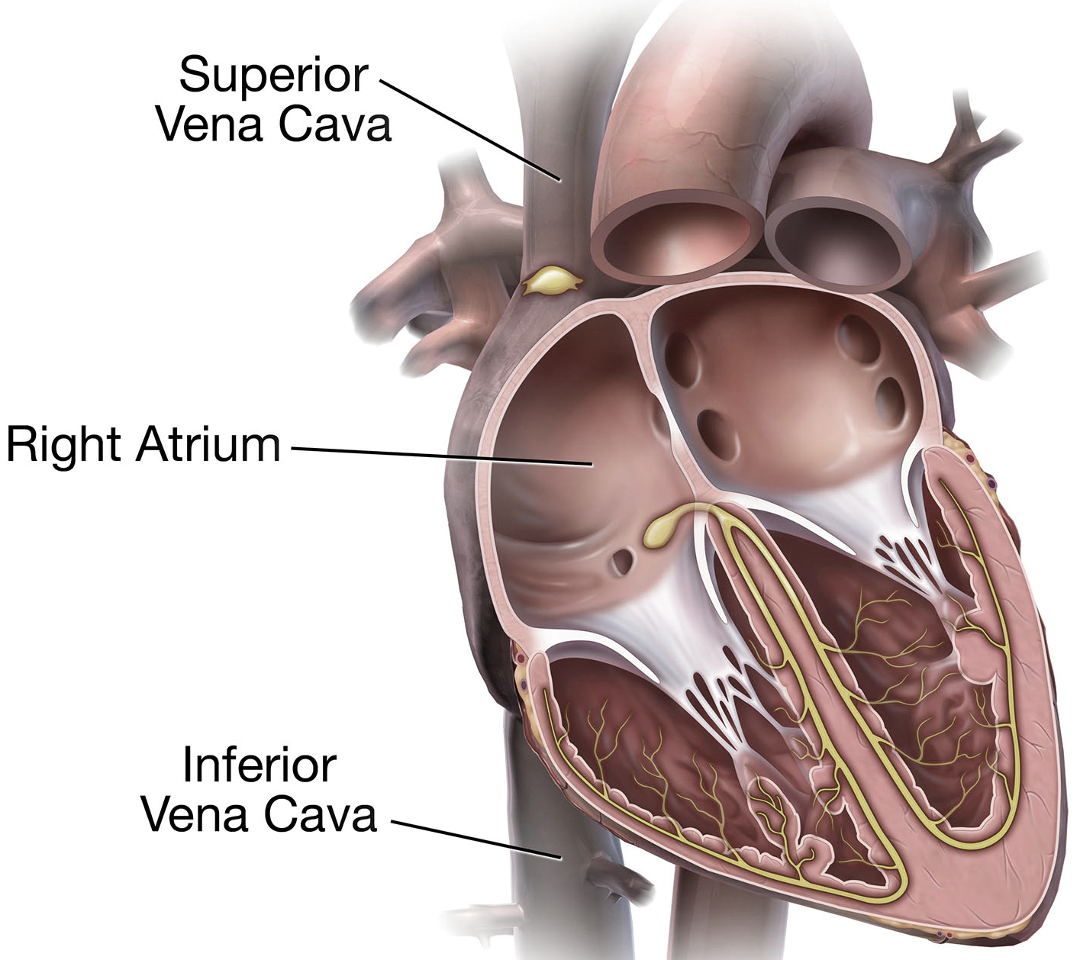

Problem statement: recap
Indifferent
663 examples
Dangerous
PREDICTION
90 examples
DATA PREPROCESSING
Cleaning from unclear traces
Doubled subject (subject 5) and signals removal
Traces alignment
Effective
94 examples

Slide 5
Outline
Problem statement: recap
Feature extraction
Envelope features
Template matching features
Short time Fourier transformation features
Classification
Feature correlation analysis
Knowledge based approach
Machine learning approach: tree - MLR - SVM
Best model evaluation
Conclusions

Slide 6
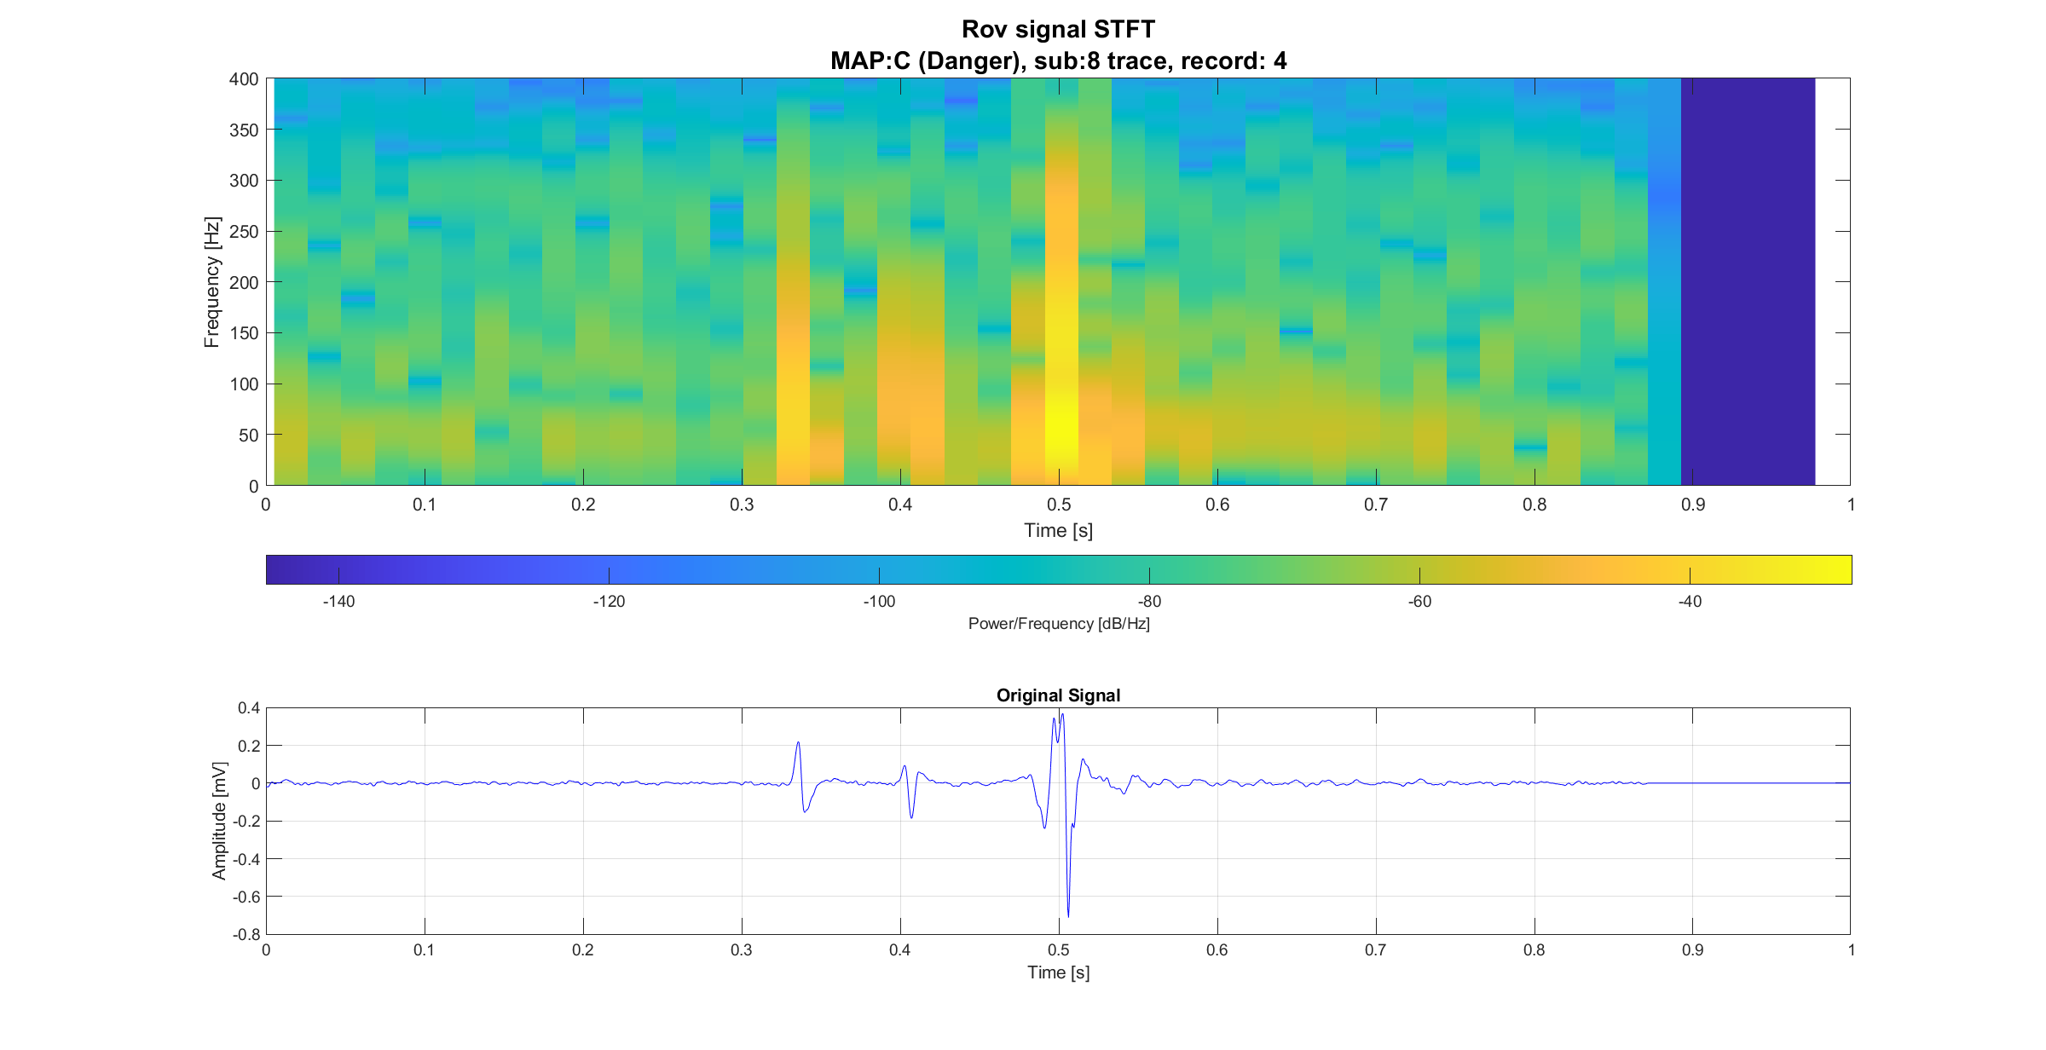
Feature extraction pipeline overview
Feature extraction
Envelope based
Template matching
STFT based
Signal active areas
Morphological information
Time-frequency information
Literature inspired [1]
Maximum amplitude and signal fragmentation
[1] G. Baldazzi, M. Orrù, G. Viola, e D. Pani, «Computer-aided detection of arrhythmogenic sites in post-ischemic ventricular tachycardia», Sci Rep, vol. 13, fasc. 1, p. 6906, apr. 2023, doi: 10.1038/s41598-023-33866-w.

Slide 7
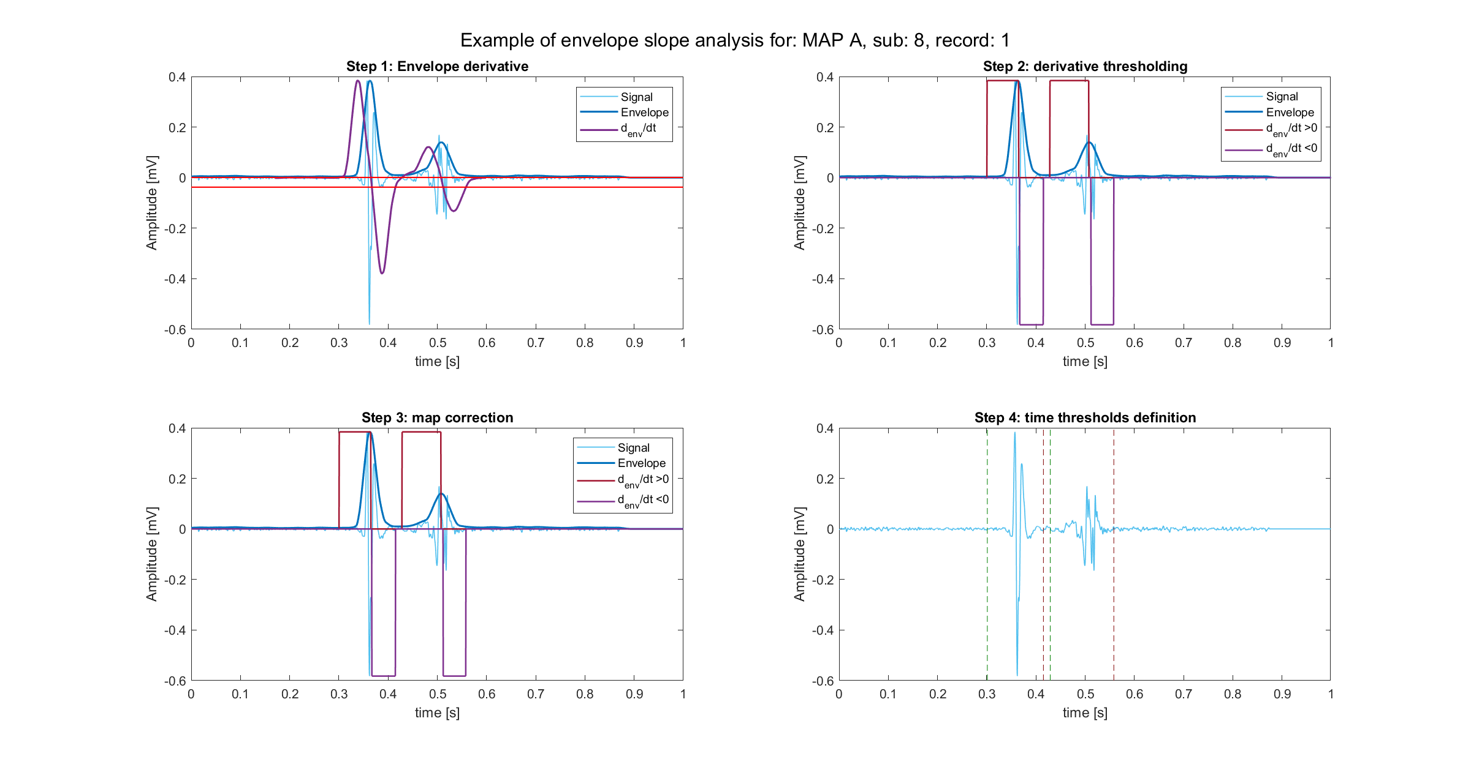
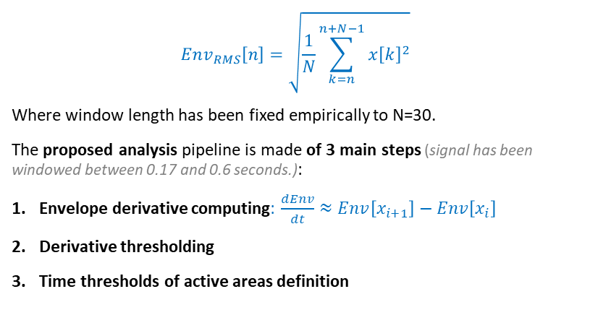
Envelope definition
Find and describe signal active areas
Active area: portion of signal with electrical activity characterised by peaks presence
$$Env_{RMS}\left[n\right]=\sqrt{\frac{1}{N}\sum_{k=n}^{n+N−1}{x{\left[k\right]}^{2}}}$$
Where window length has been fixed empirically to N=30.
The proposed analysis pipeline is made of 3 main steps (signal has been windowed between 0.17 and 0.6 seconds.):
Envelope derivative computing: $\frac{dEnv}{dt}≈Env\left[x_{i+1}\right]−Env\left[x_{i}\right]$
Derivative thresholding
Time thresholds of active areas definition

Slide 8
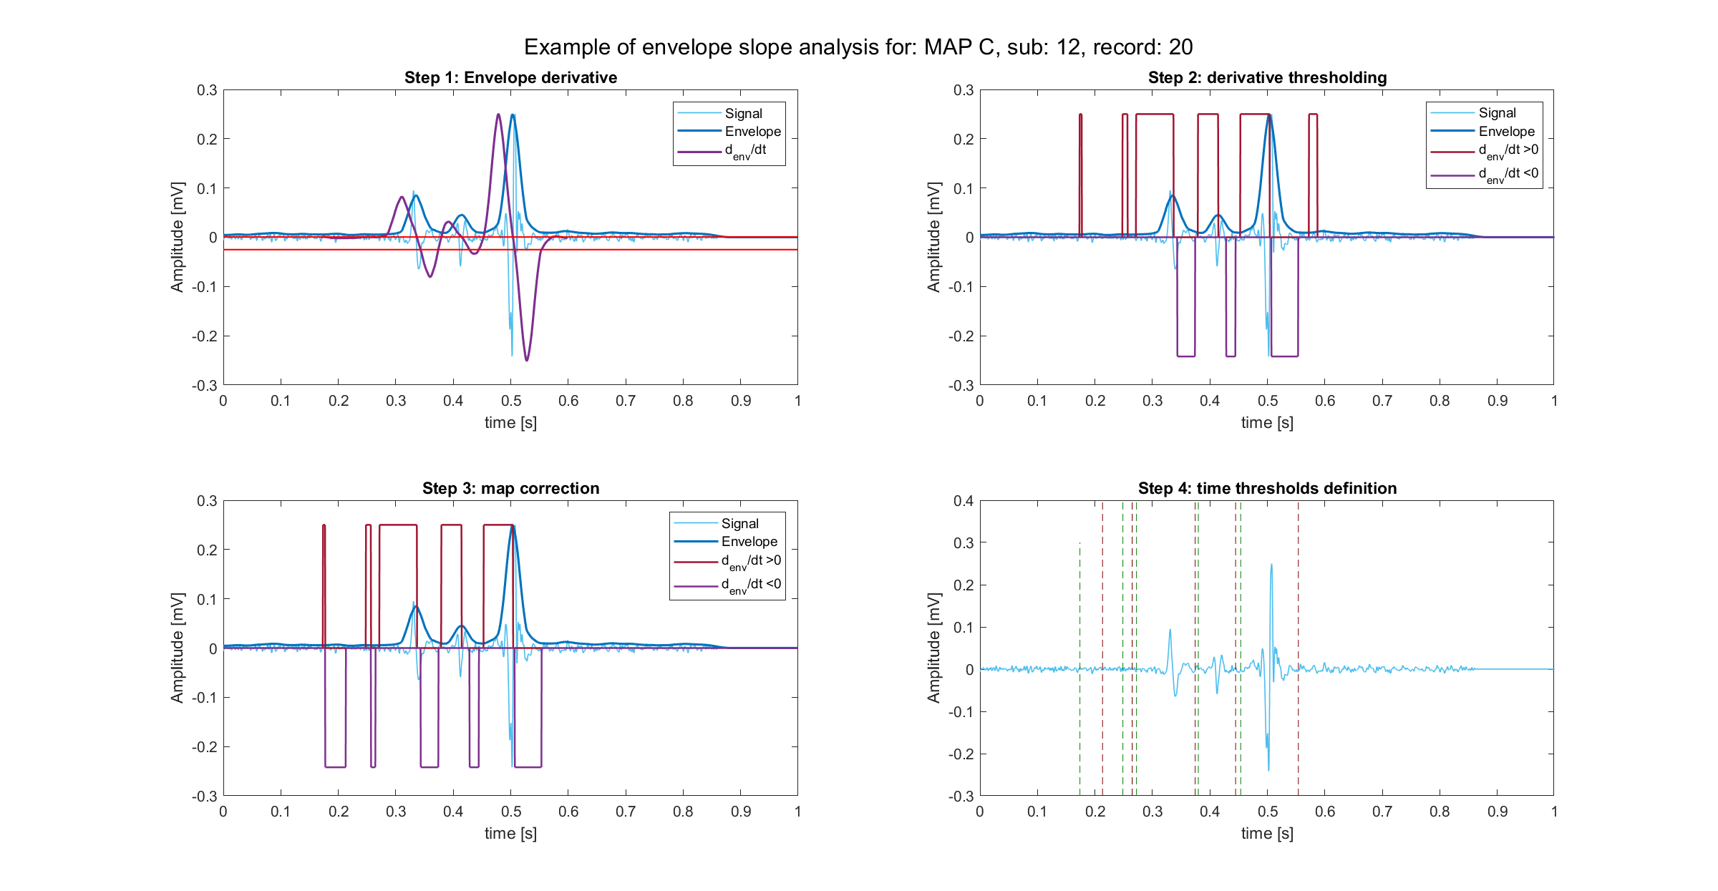
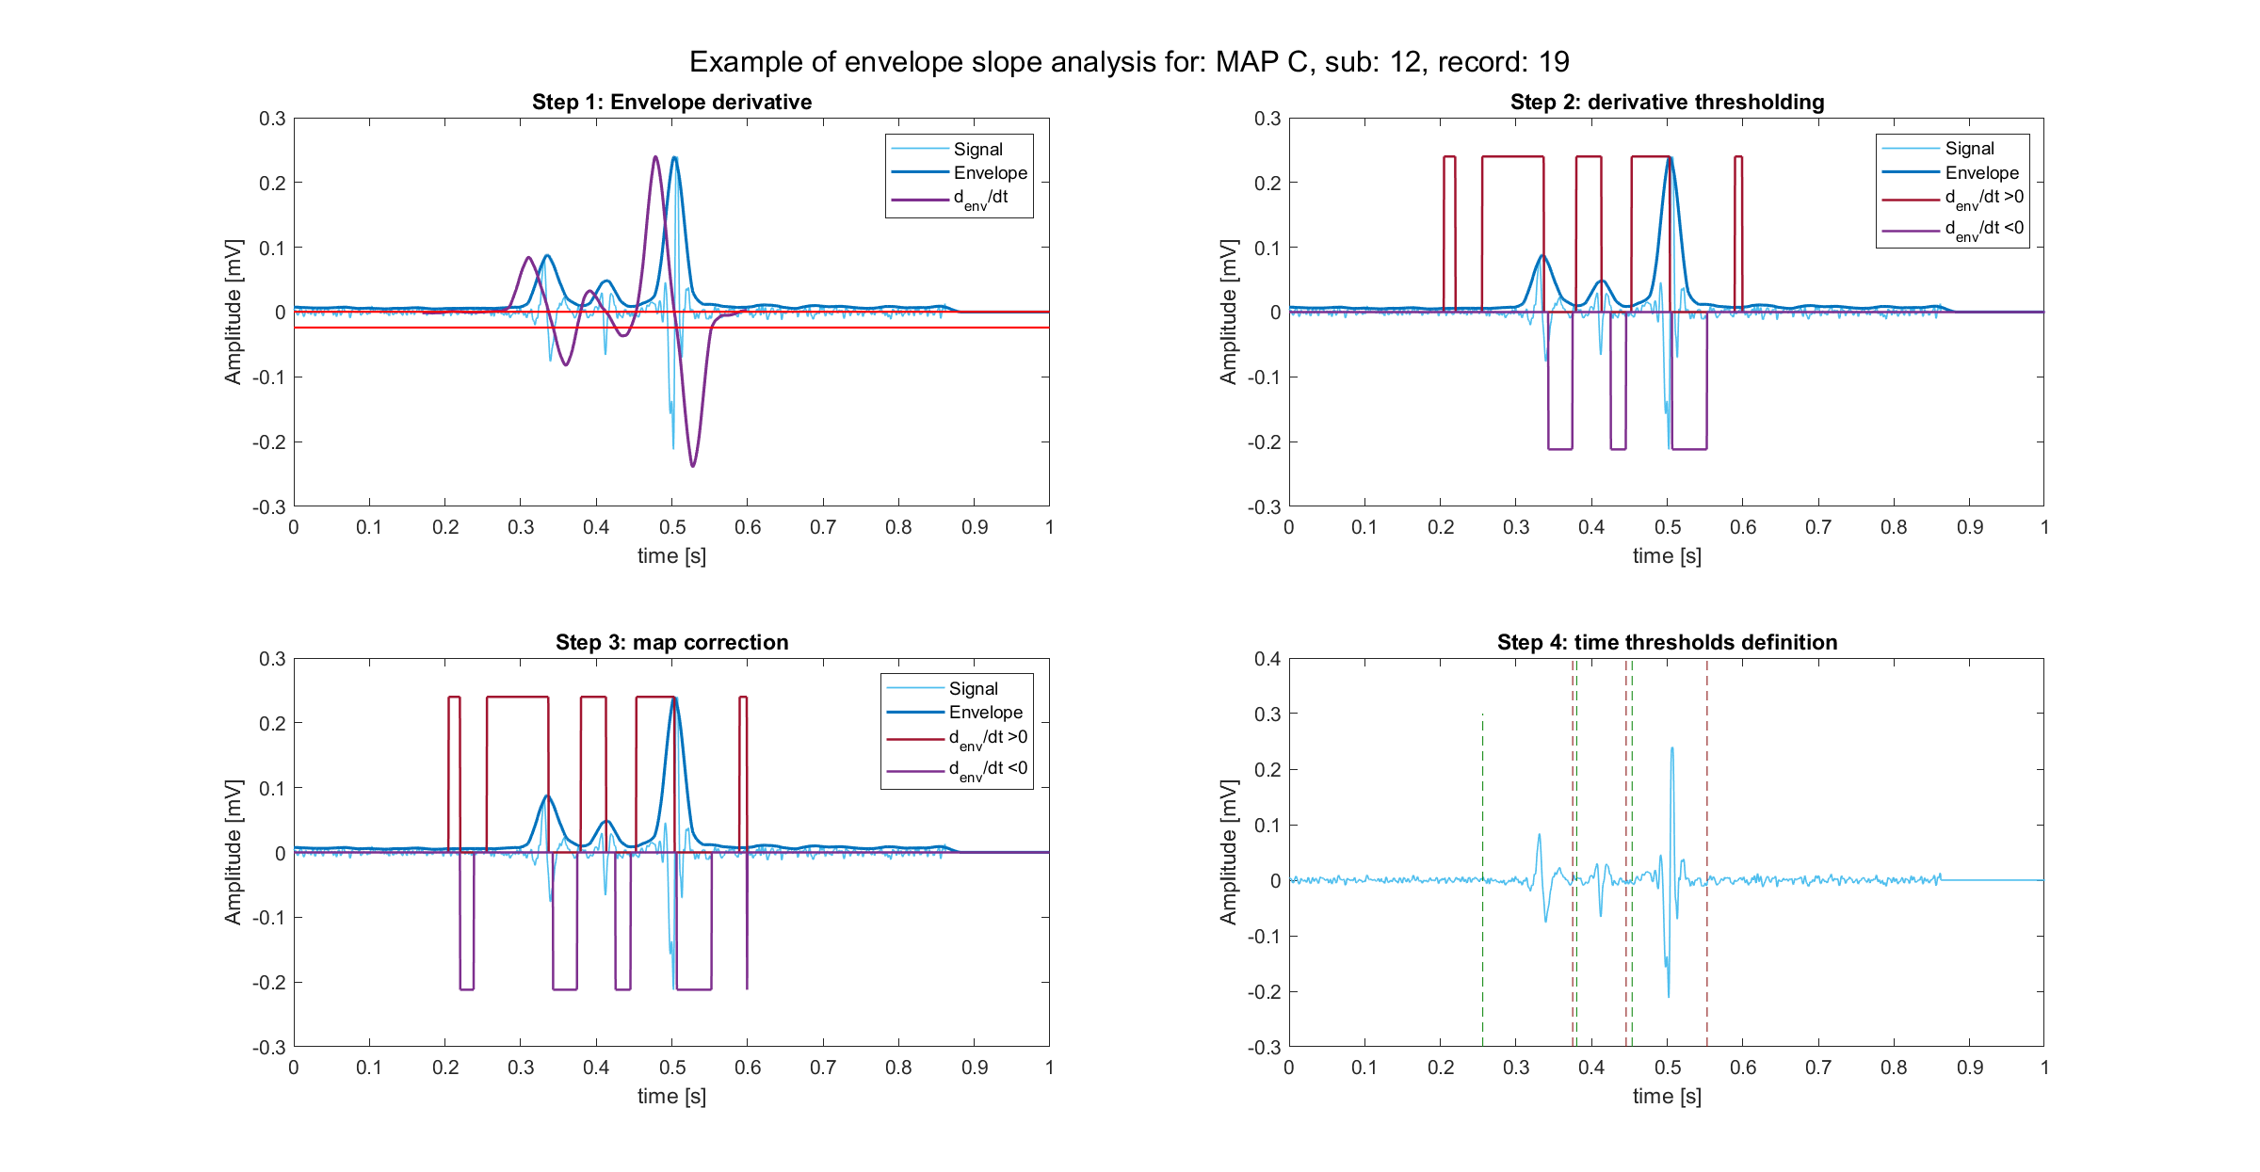
Envelope features
Starting from active areas definition the following features have been computed:
Number of active area detected
Signal and envelope peaks absolute values
In order of magnitude: Dominant, Subdominant, Minor peak value and time (3 features from Rov signal + 3 features from envelope signal)
In order of occurrence: First, Second, Third peak value and time (3 features from Rov signal + 3 features from envelope signal)
Duration of active signal
Silent phase within signal duration
Ratios between couple of features
Atrio to ventricular ratio, subdominant to dominant ratio…
1
2
3

Slide 9
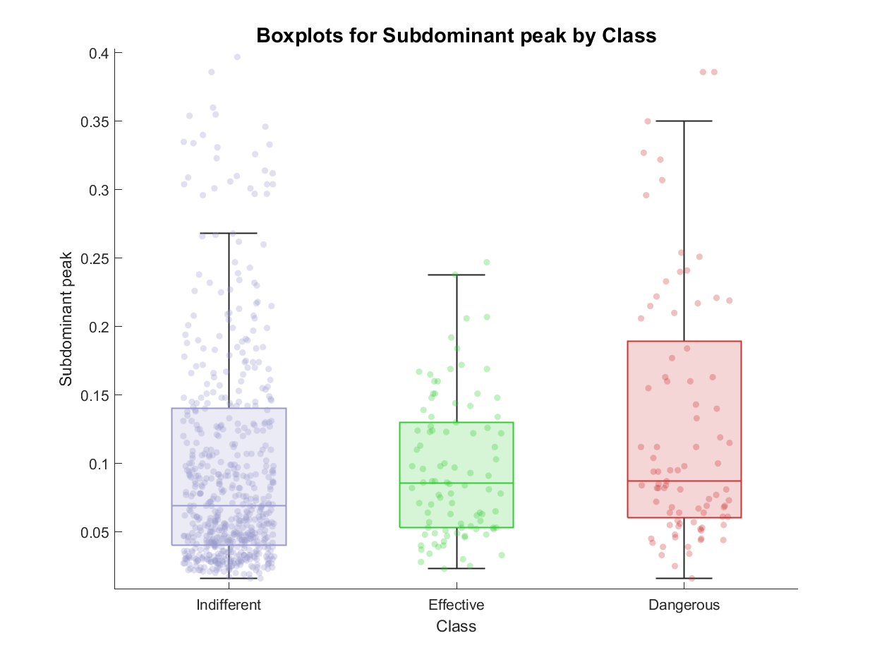
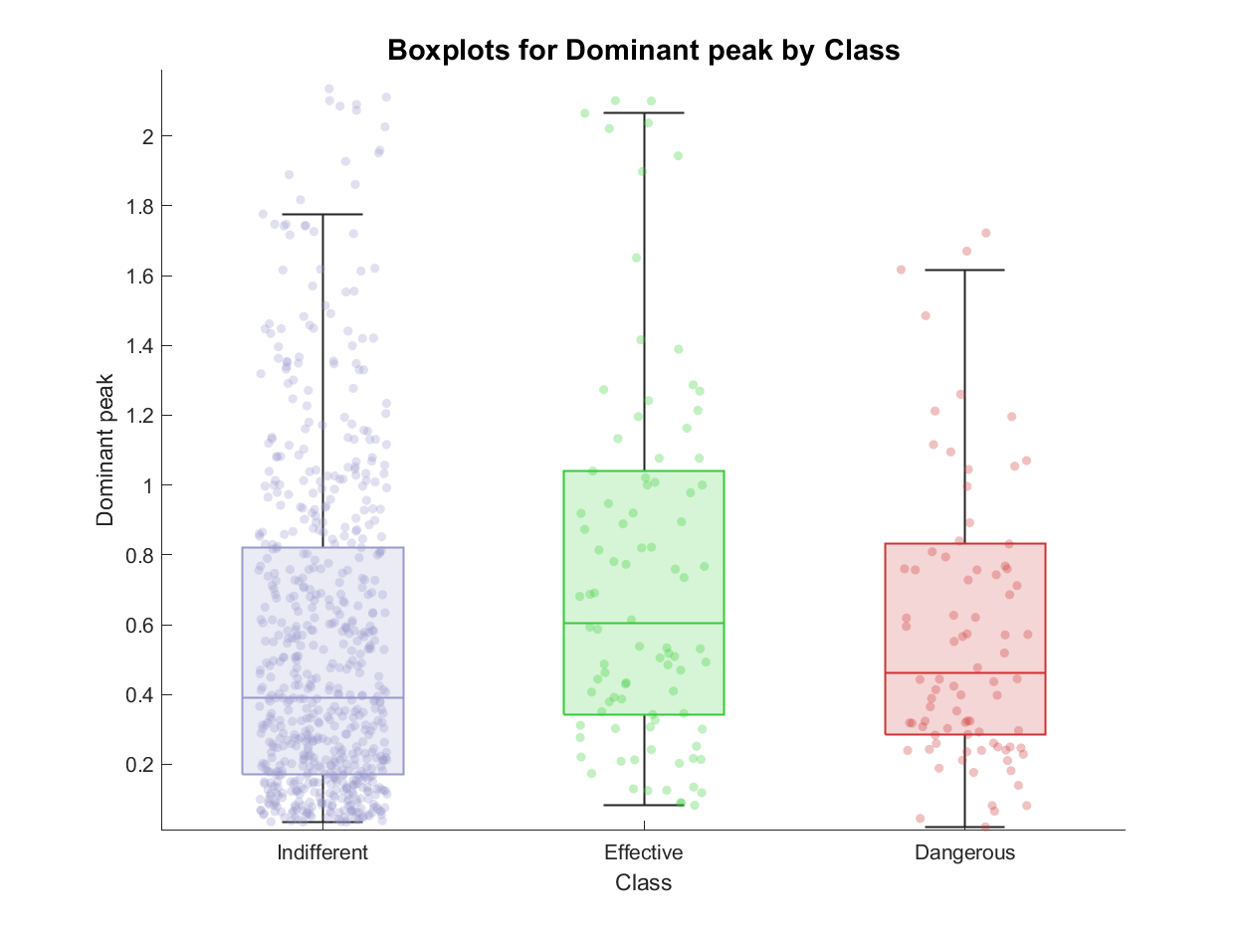
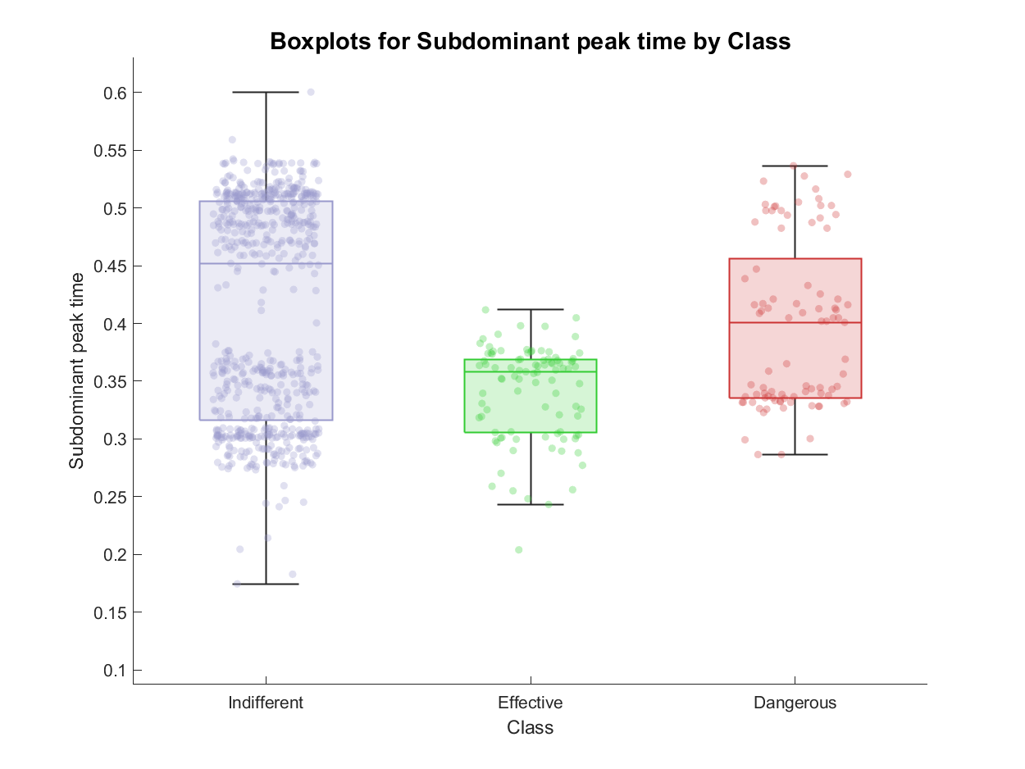
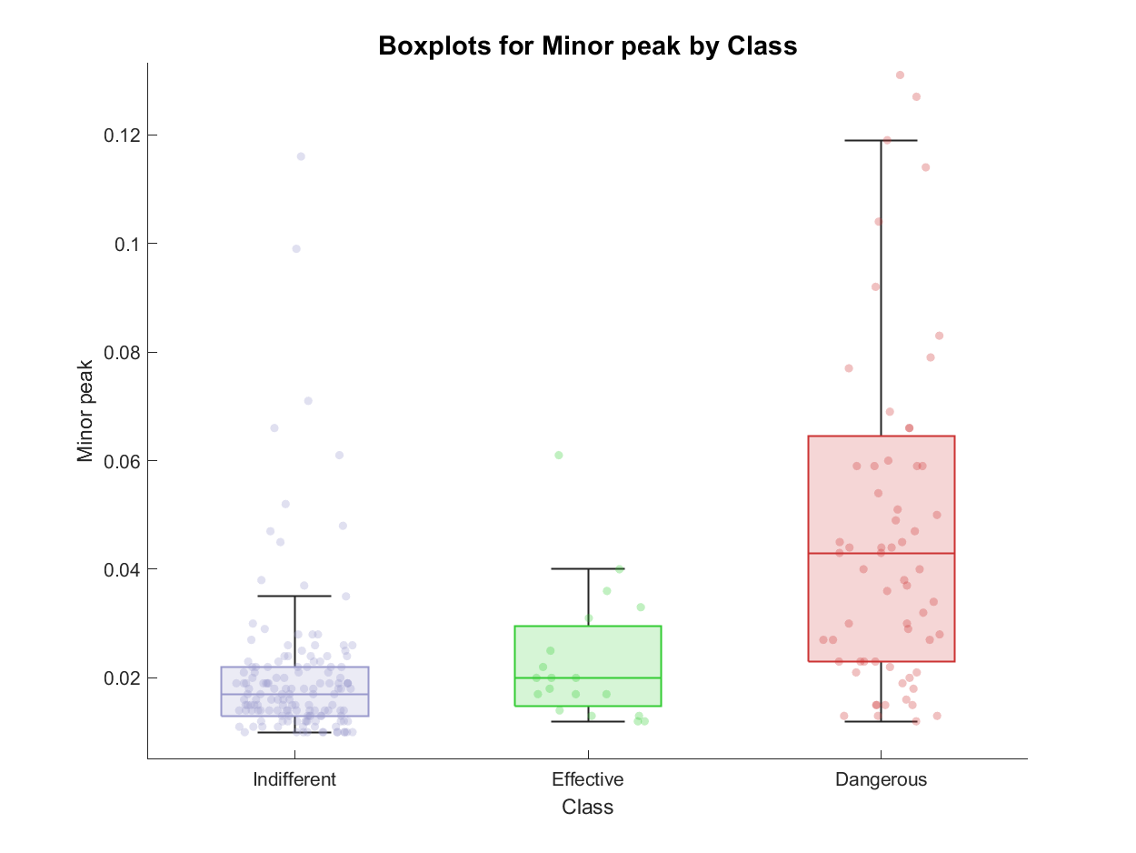
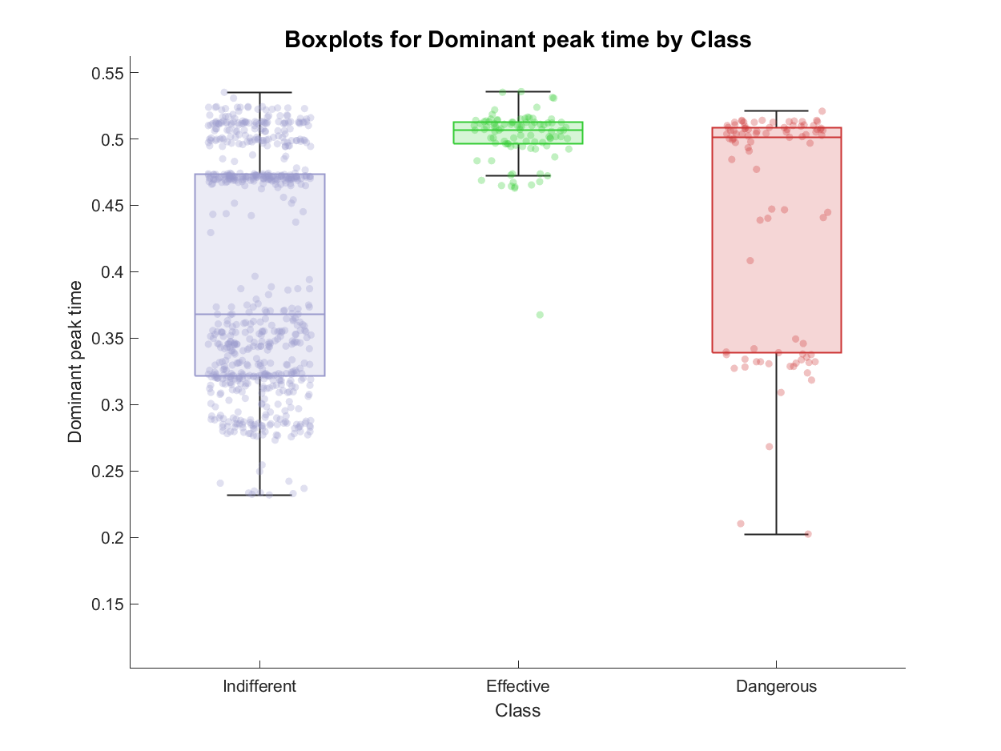
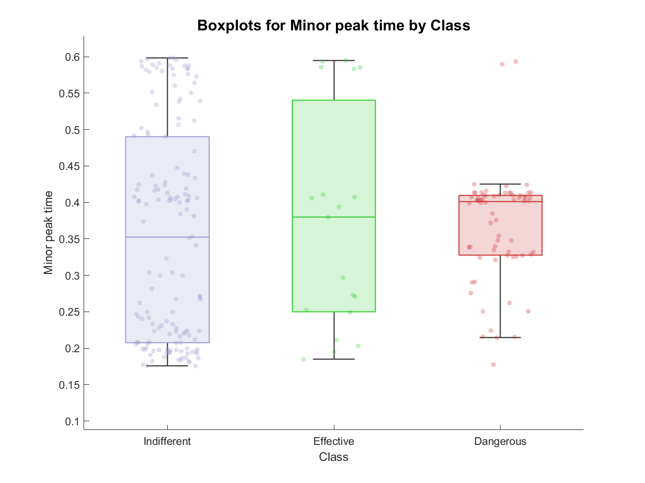
Envelope feature extraction: examples of features
Dominant peak value and time
Subdominant peak value and time
Minor peak value and time

Slide 10
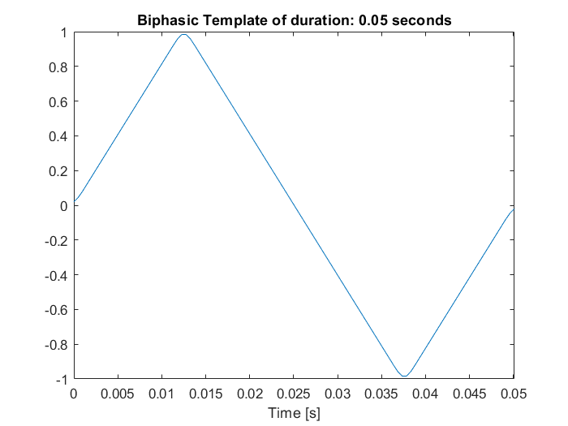
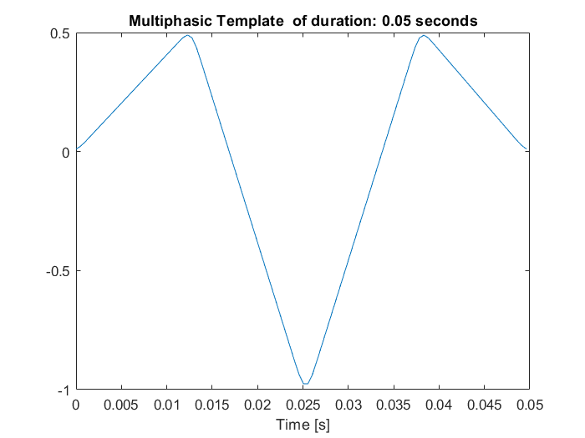
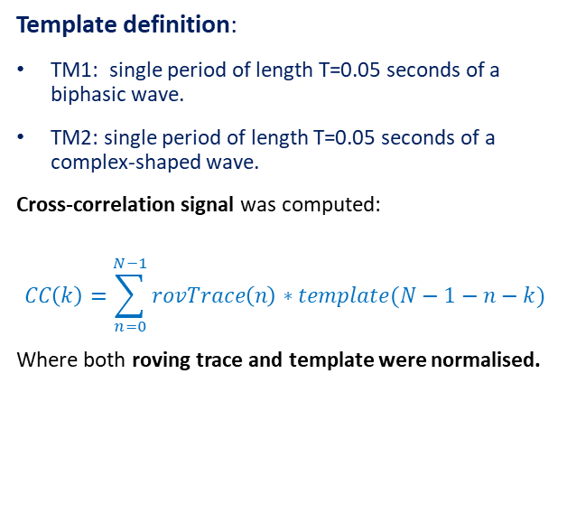
Template matching definition
Evaluate morphological properties
E.g., indifferent signals have simple and biphasic shape, while effective ones have complex and multiphasic shapes
Template definition:
TM1: single period of length T=0.05 seconds of a biphasic wave.
TM2: single period of length T=0.05 seconds of a complex-shaped wave.
Cross-correlation signal was computed:
$$CC\left(k\right)=\sum_{n=0}^{N−1}{rovTrace\left(n\right)∗template(N−1−n−k)}$$
Where both roving trace and template were normalised.

Slide 11
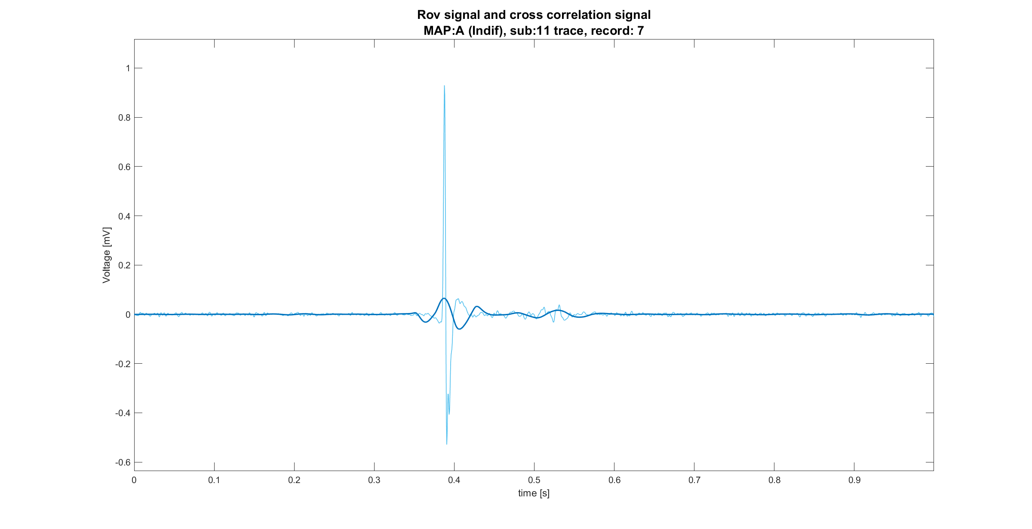
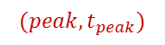
Template matching features
For each template the following features were defined directly onto the cross-correlation signal:
Maximum value
Maximum time position
Energy of cross correlated signal
$$(peak,t_{peak})$$

Slide 12
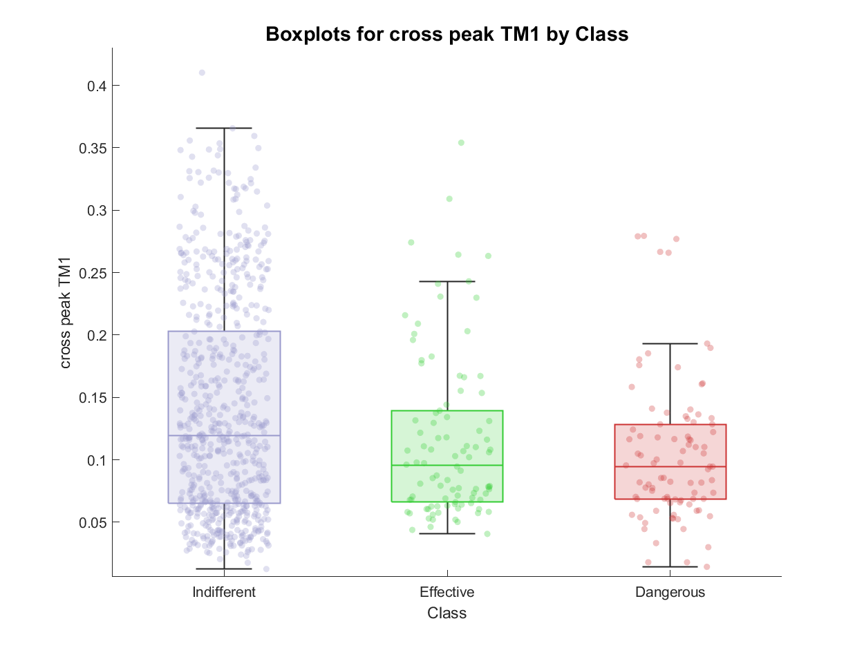
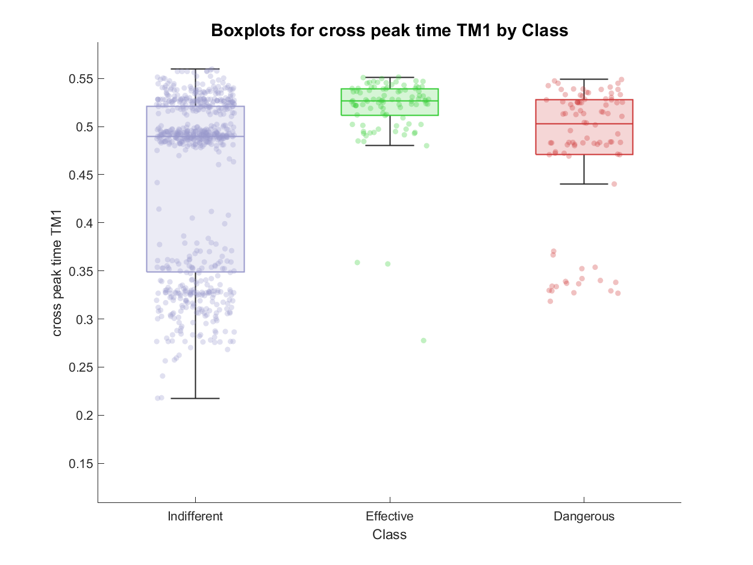
TM feature extraction: examples of features
Cross correlation peak value and time (TM1)

Slide 13
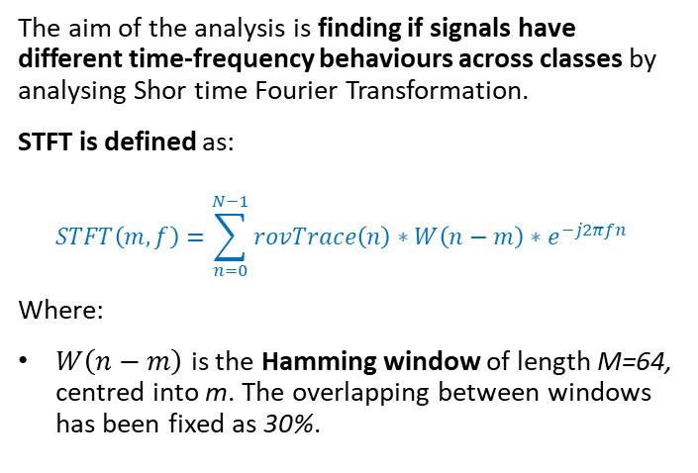
STFT definition
Analyse time-frequency behaviour
The aim of the analysis is finding if signals have different time-frequency behaviours across classes by analysing Shor time Fourier Transformation.
STFT is defined as:
$$STFT\left(m,f\right)=\sum_{n=0}^{N−1}{rovTrace\left(n\right)∗W\left(n−m\right)∗e^{−j2πfn} }$$
Where:
$W\left(n−m\right)$ is the Hamming window of length M=64, centred into m. The overlapping between windows has been fixed as 30%.

Slide 14
STFT features definition
Power features were defined dividing each active area detected into three sub-bands:
low frequency sub-band: 0-75 Hz
medium frequency sub-band: 75-150 Hz
high frequency sub-band: 150-350 Hz
Then, for each active area and into each sub-band the following features were defined:
Average power (average of pixels)
Maximum power (maximum pixel value)
Minium power (minimum pixel value)
Standard deviation of power values (pixels)

Slide 15
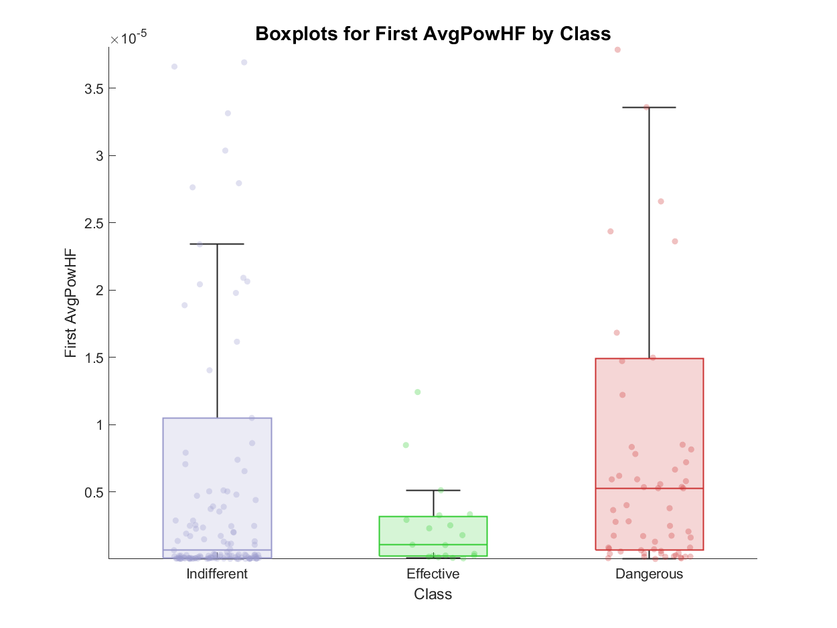
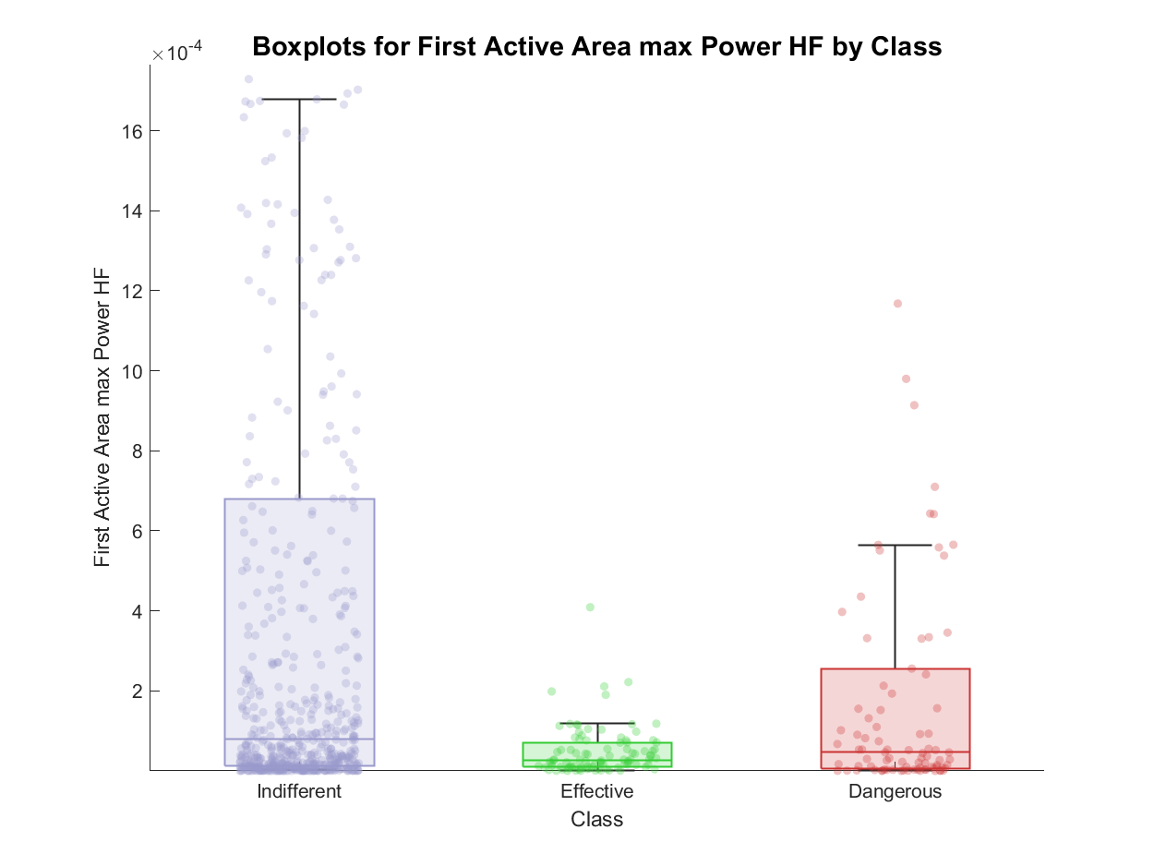
STFT feature extraction: examples of features
First active area HF sub-band: average and maximum power

Slide 16
Outline
Problem statement: recap
Feature extraction
Envelope features
Template matching features
Short time Fourier transformation features
Classification
Feature correlation analysis
Knowledge based approach
Machine learning approach: tree - MLR - SVM
Best model evaluation
Conclusions

Slide 17
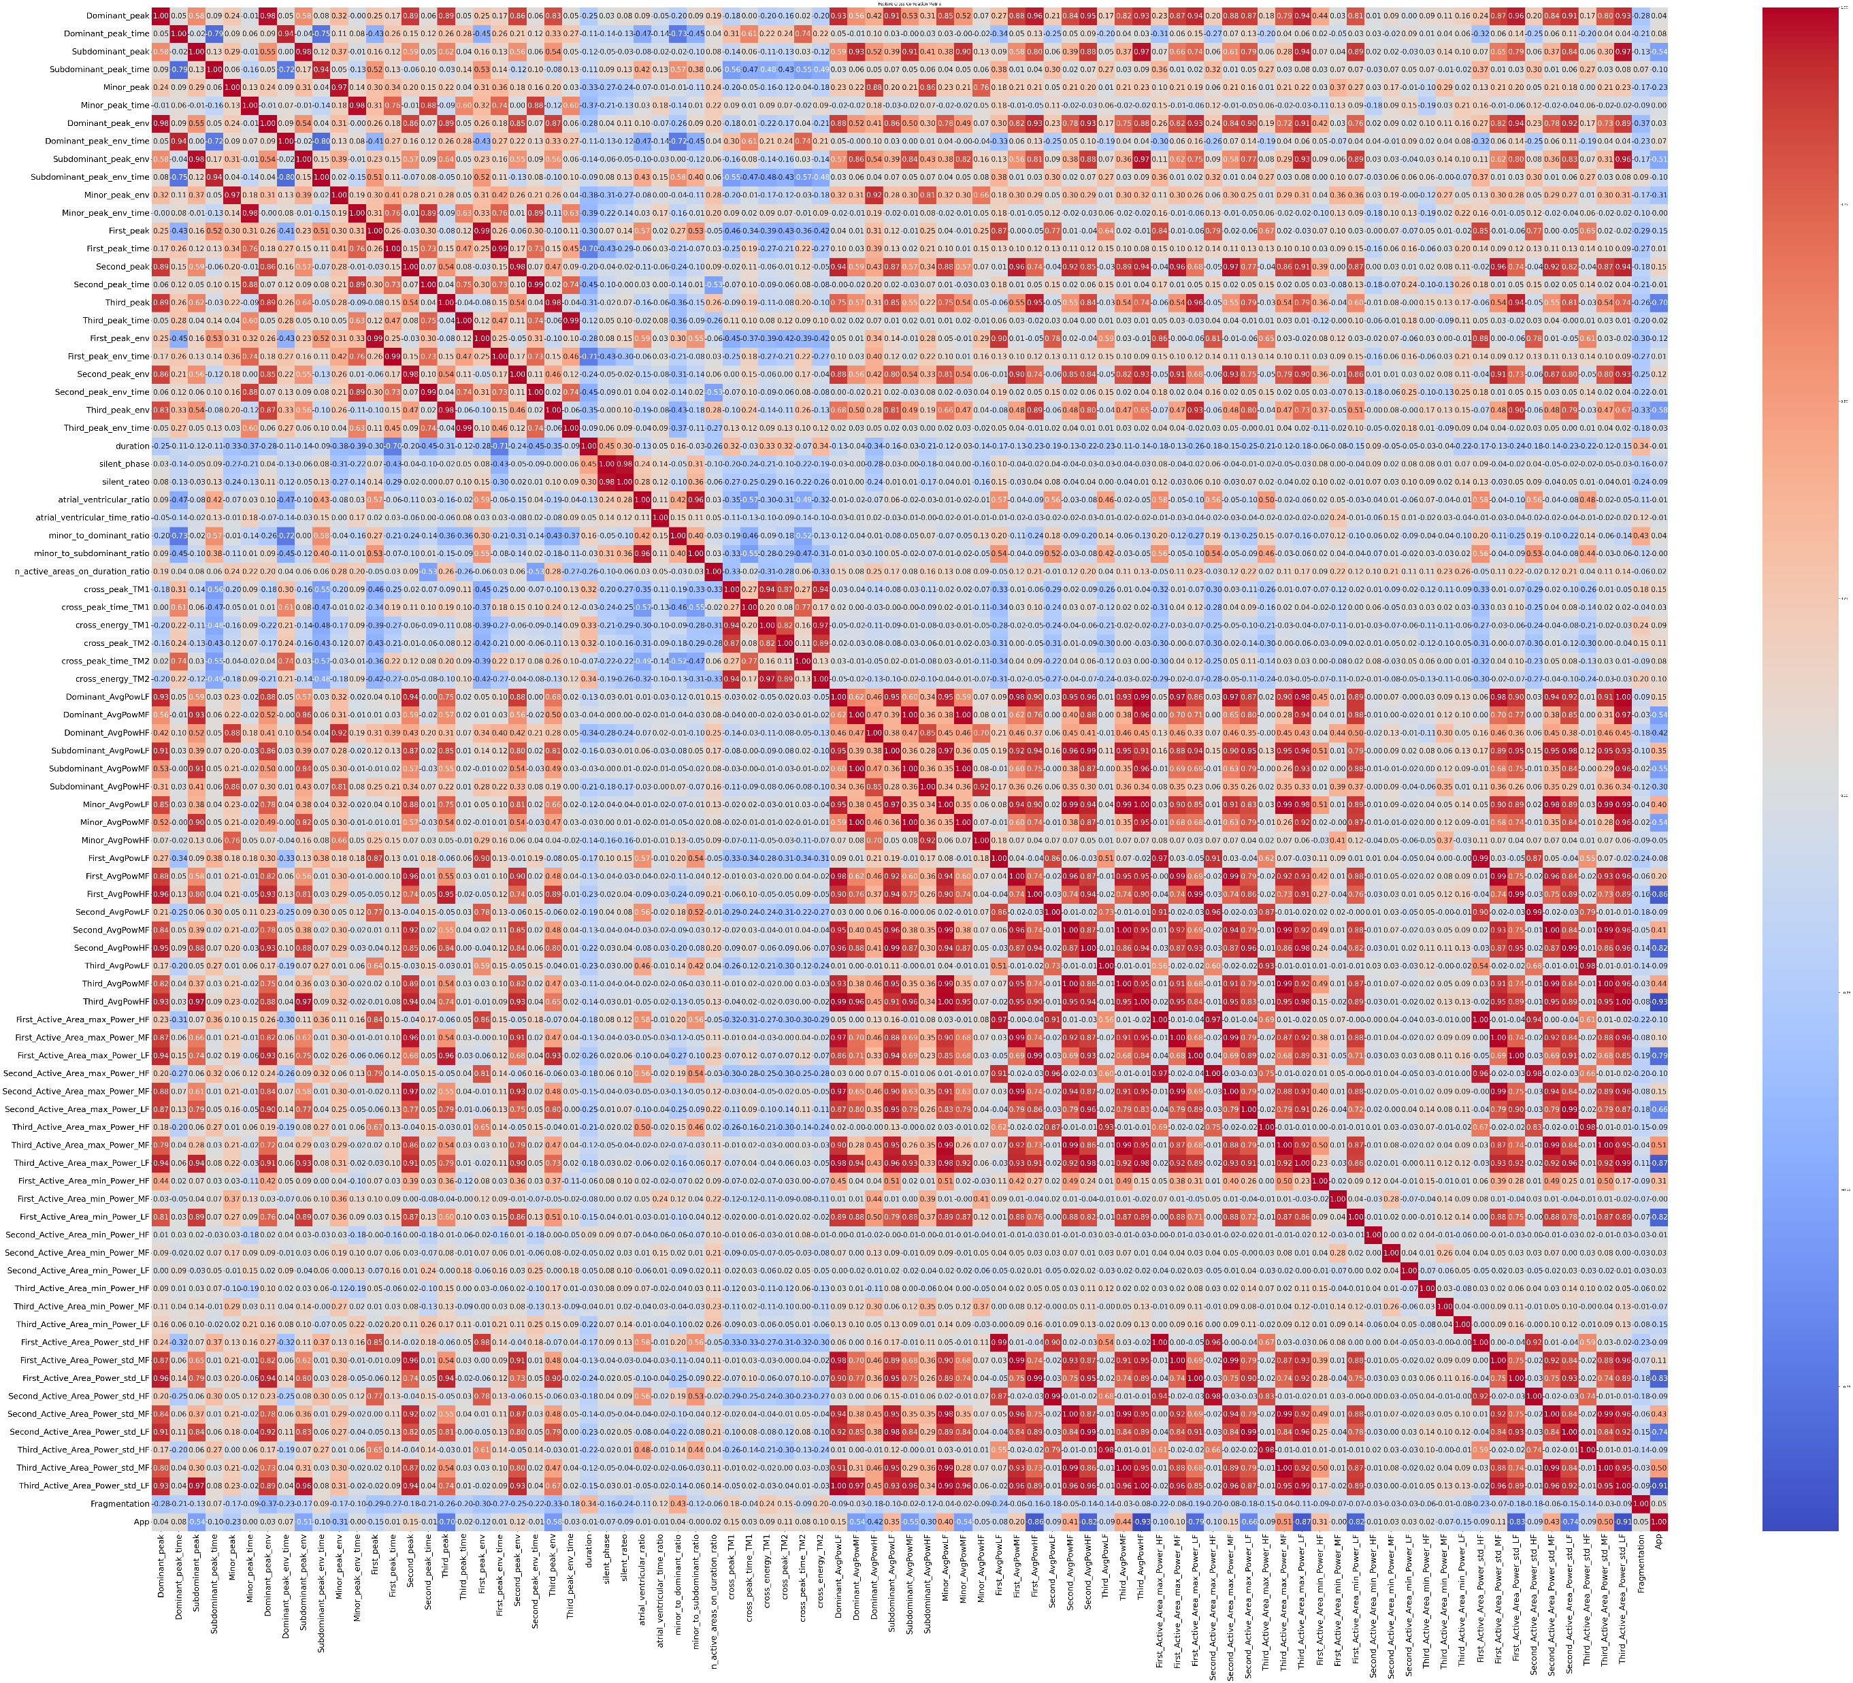
Feature correlation analysis
To avoid the usage of features correlated between each other, correlation matrix has been computed and some of:
Envelope features
Template Matching features
STFT features
Literature inspired features
Were excluded from the analysis
From an initial number of 87 features, a dataset of 56 features was obtained.

Slide 18
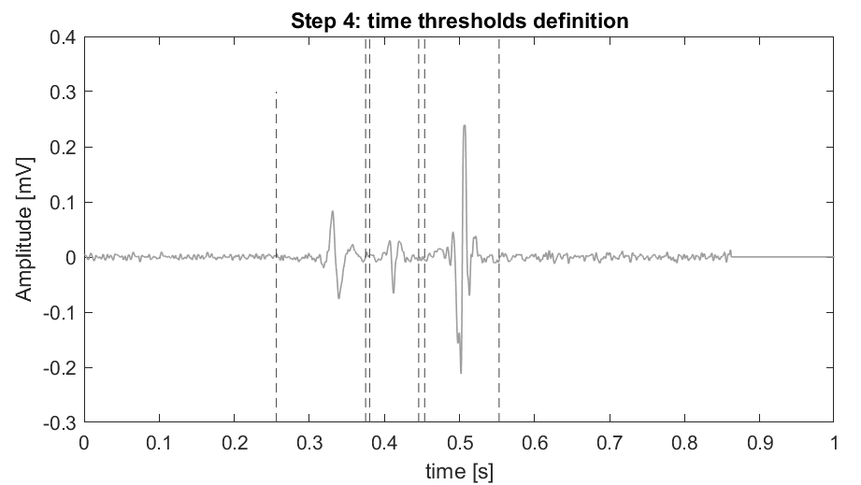


Knowledge based classifier
Four knowledge-based classifiers were defined, and the best one is reported.
Aim: assess if a KB classifier can meet the problem
Feature extraction
Is Minor_peak >0.021?
No
Is Dominant_peak_time <0.49
No
Effective
Yes
Yes
Dangerous
Indifferent

Slide 19
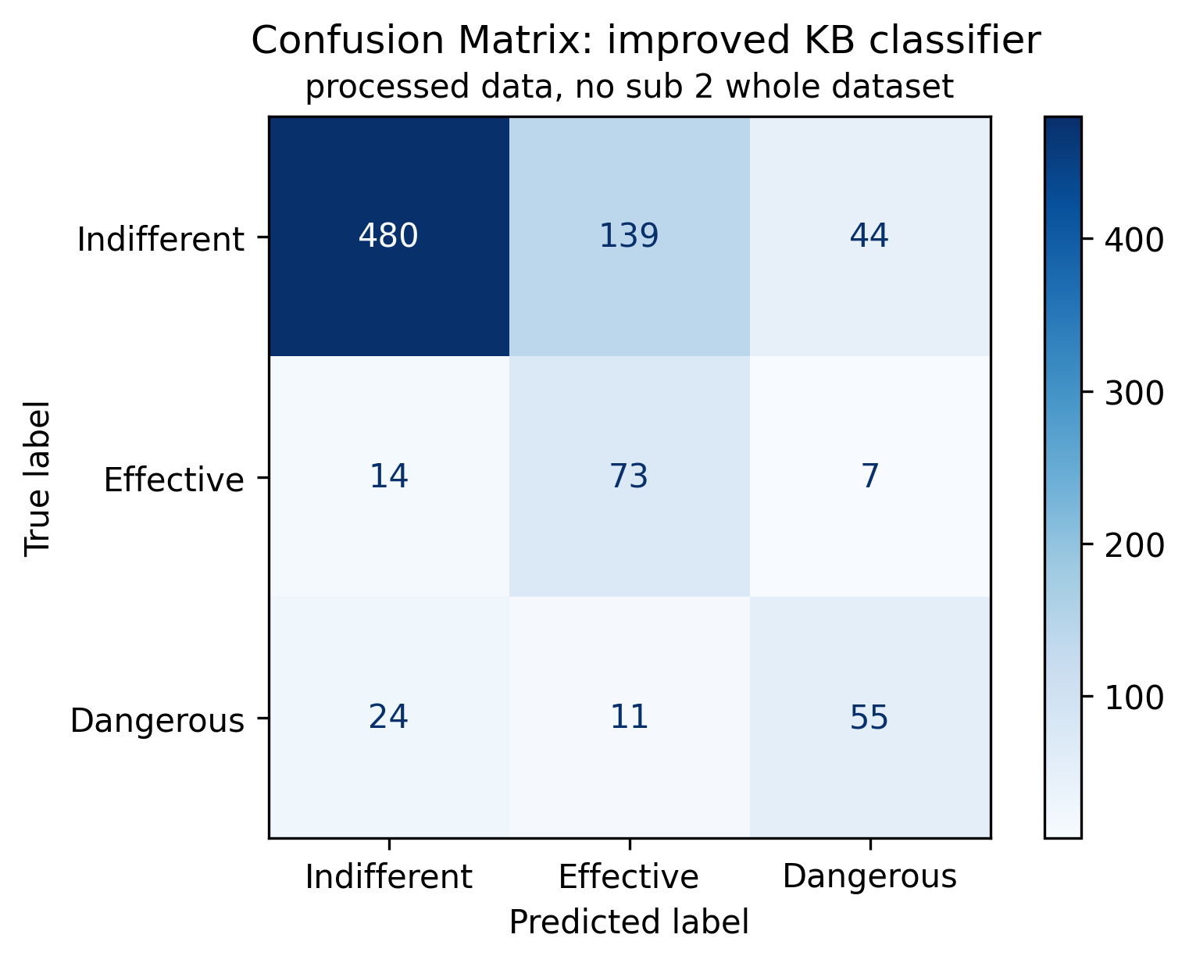
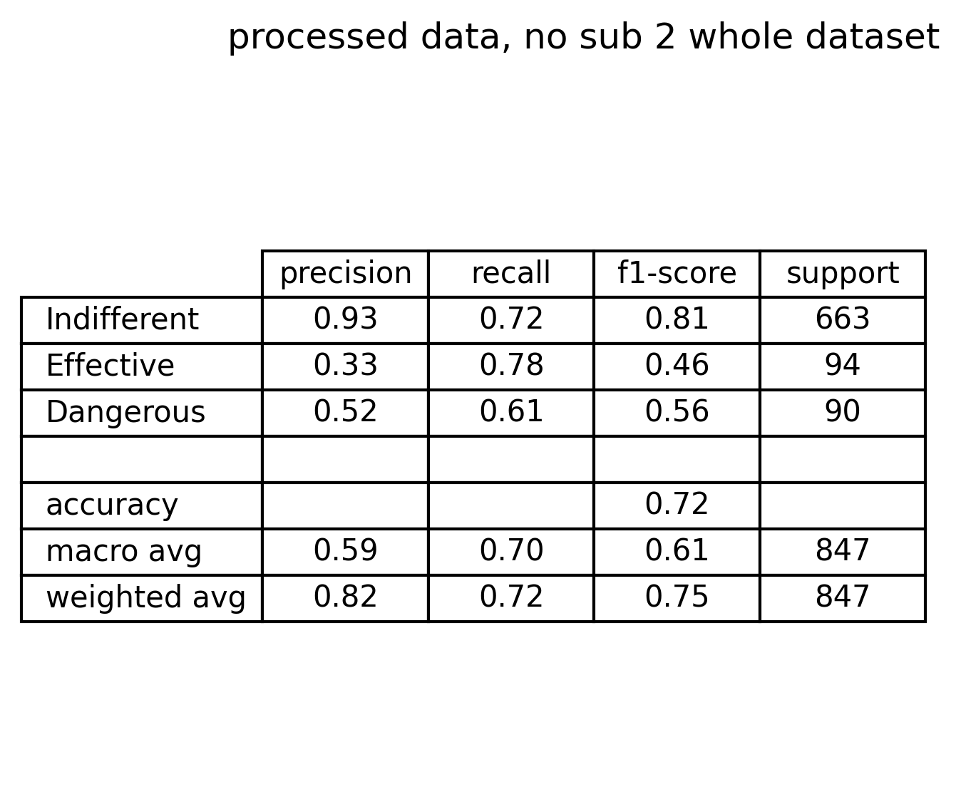
Knowledge based classifier performance
Comments on confusion matrix and metrics:
Indifferent signals have good performance
Effective signals suffer of bad precision but sufficient recall
Dangerous signals suffer of both low precision and recall
There are 11 dangerous signals classified as effective (very critical scenario)
There are 44 indifferent signals recognized as dangerous (acceptable scenario)
There are 24 dangerous signals classified as indifferent (risky scenario)

Slide 20
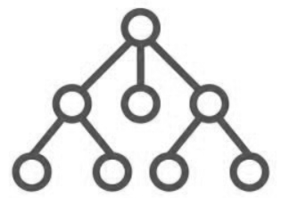
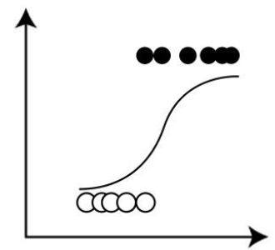
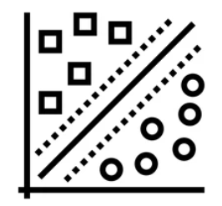
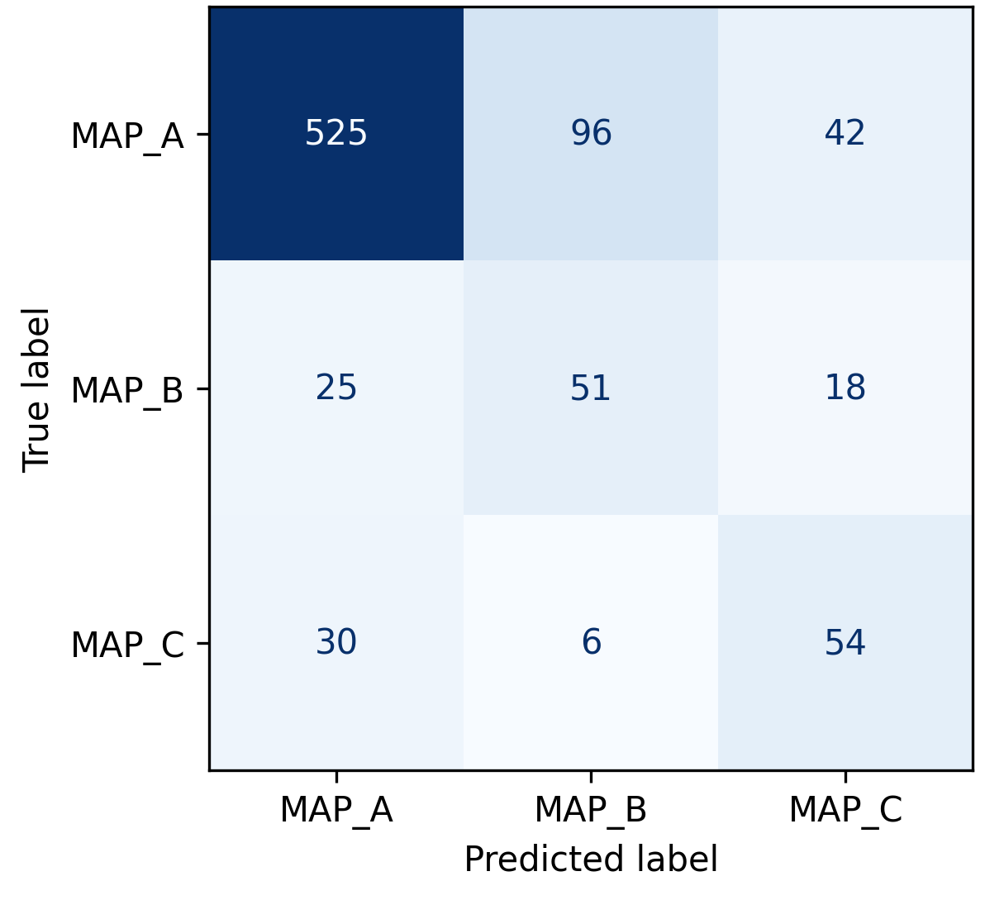
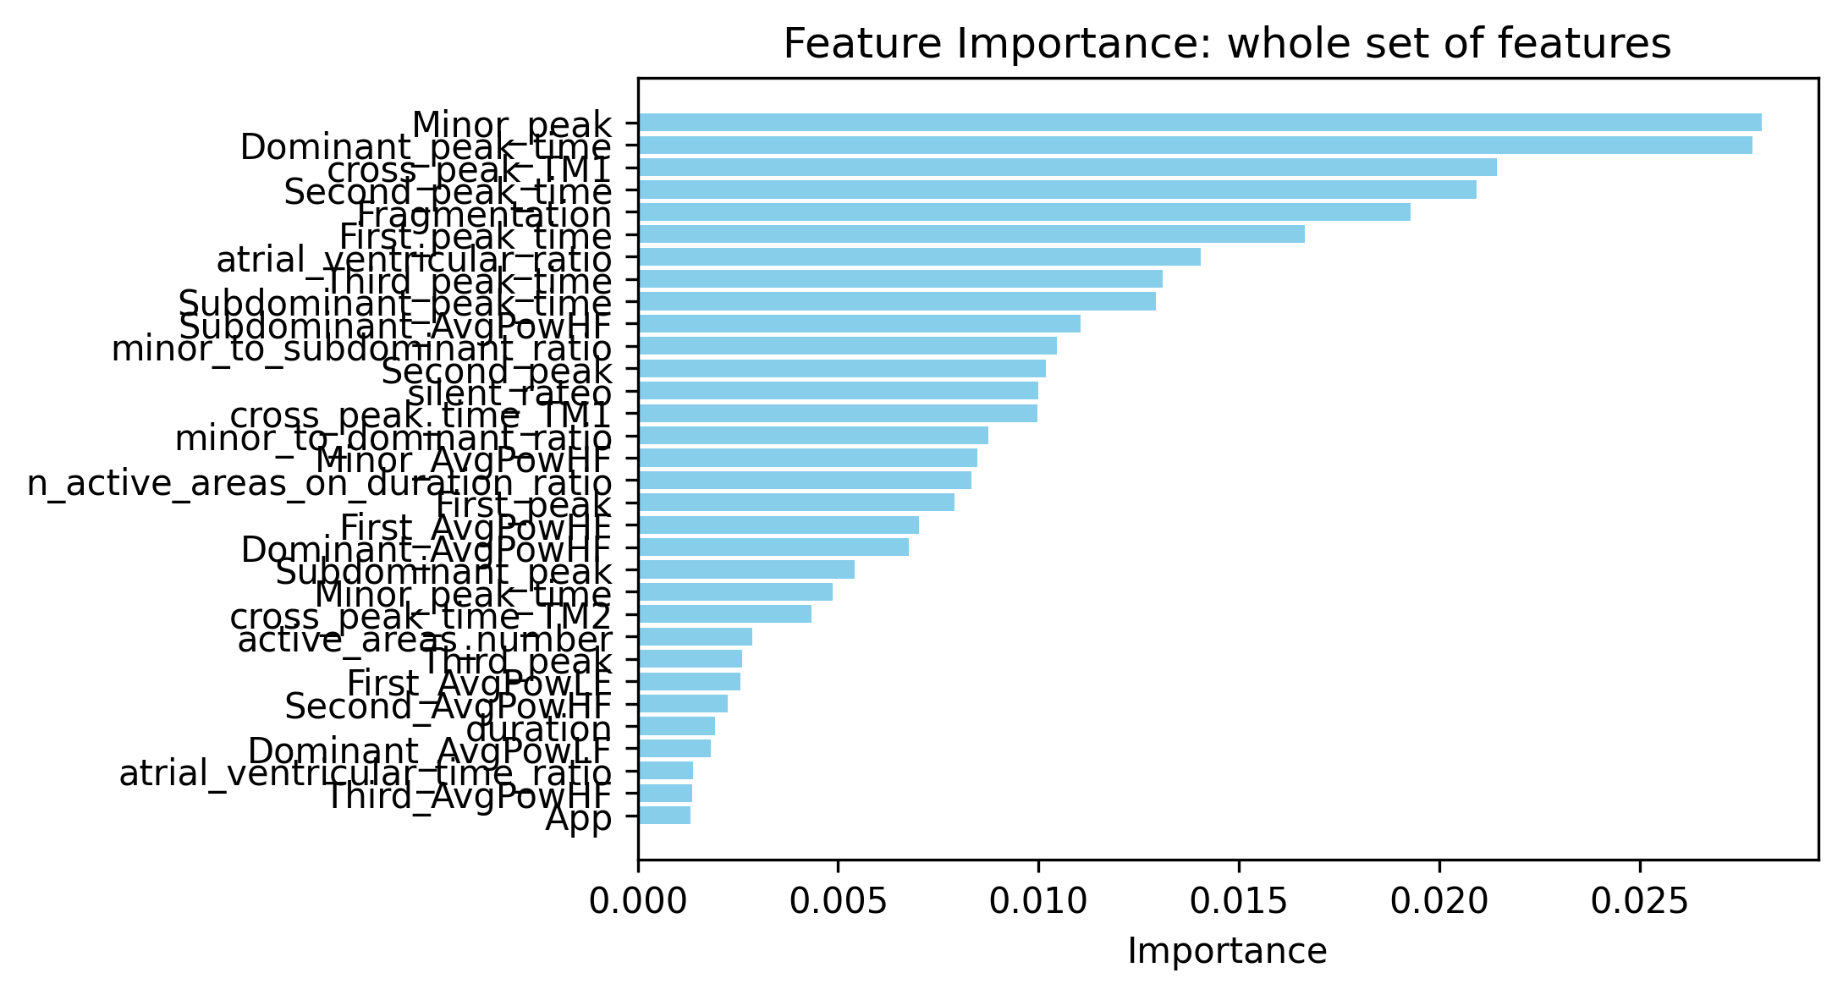
Machine learning approaches
Tree different machine learning models were used:
Tree classifier: simple and fully explainable, is similar to the knowledge-based approach
Multinomial logistic regression: simple and interpretable, provides a probabilistic output
Support vector machine classifier: less simple and hardly interpretable, capture nonlinear relationships and separability of classes
Models were validated using Leave One Patient Out cross validation and classification metrics, together with feature importance, were computed.
Each model were first built onto the whole feature set, then reduced to the optimal feature subset (reported results)
Feature extraction
LOPOCV

Slide 21
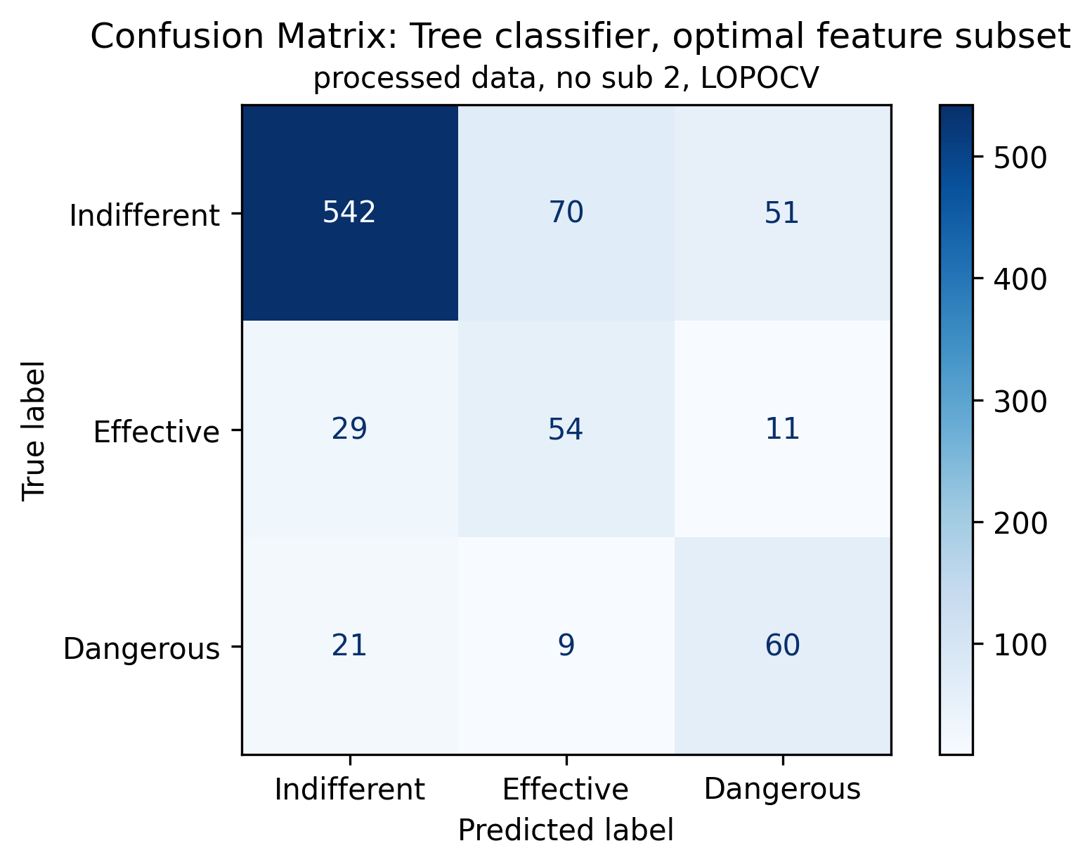
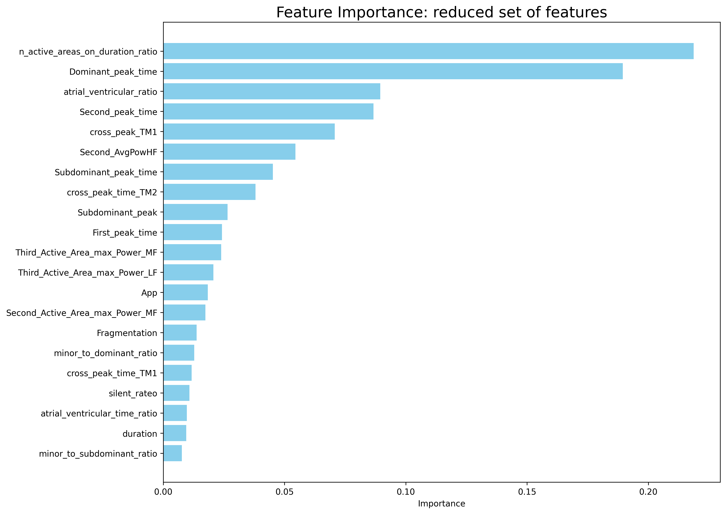
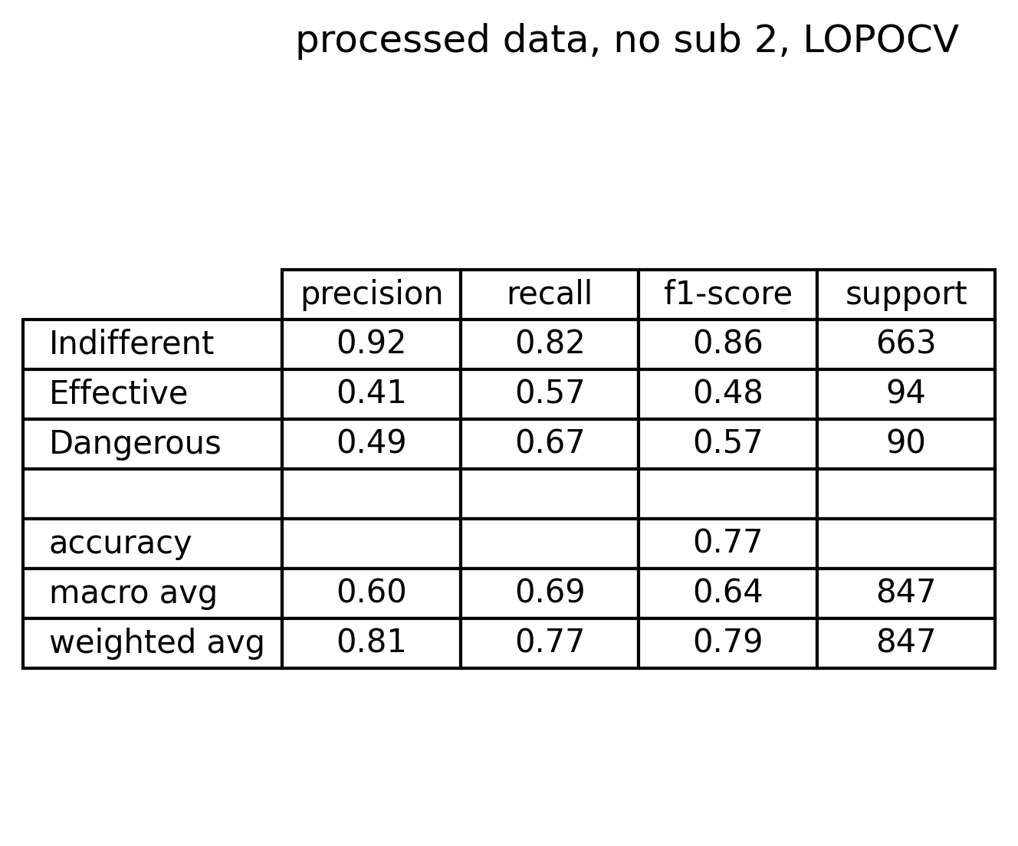
Tree classifier – optimal subset of features
Cross entropy impurity measure
Depth tuned on weighted f1-score
Comments on confusion matrix and metrics:
Indifferent signals have good performance
Effective signals suffer of bad precision and low recall
Dangerous signals suffer of both low precision and recall
9 dangerous signals classified as effective (very critical scenario)
70 effective signals recognized as indifferent (risky scenario)
51 indifferent signals recognized as dangerous (acceptable scenario)
21 dangerous signals classified as indifferent (risky scenario)

Slide 22
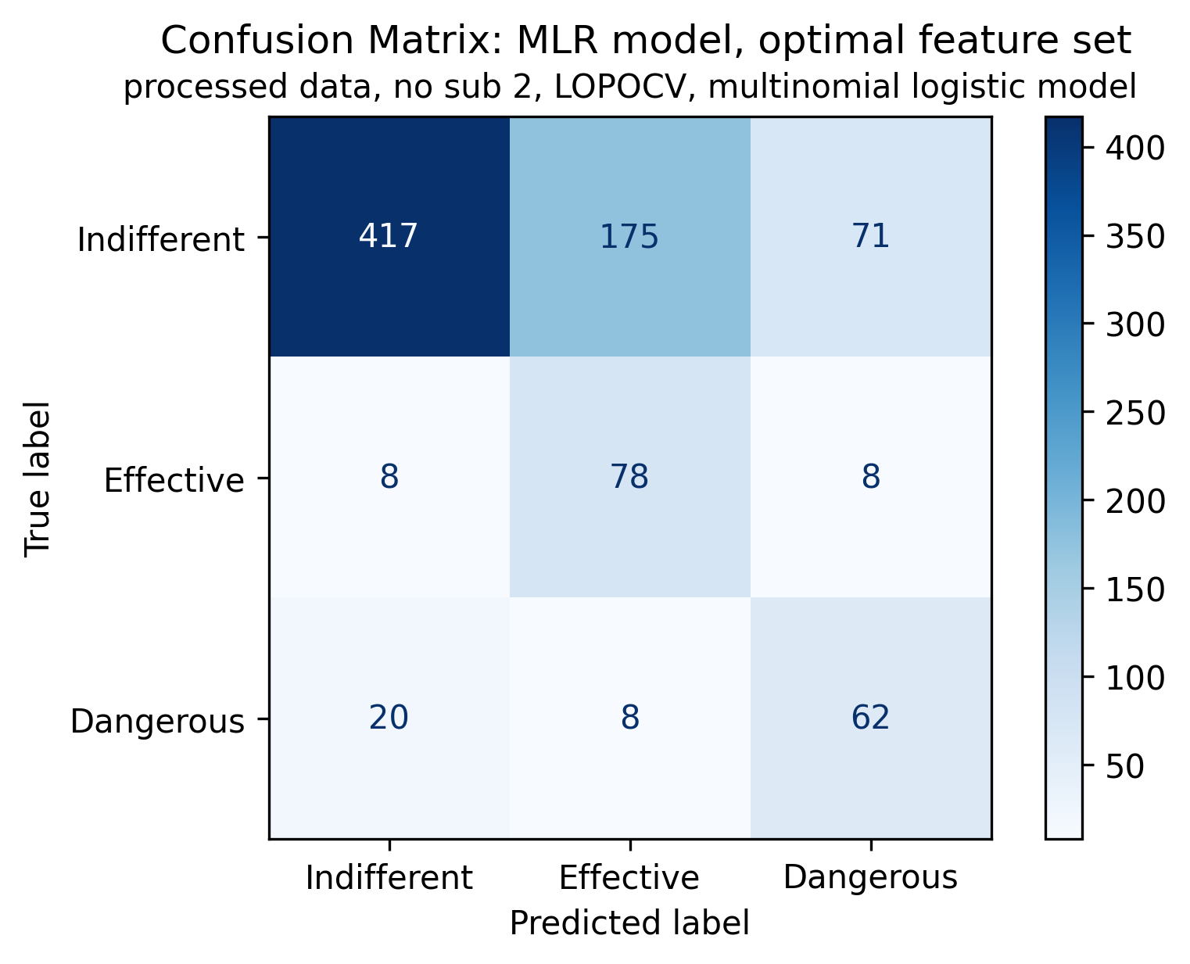
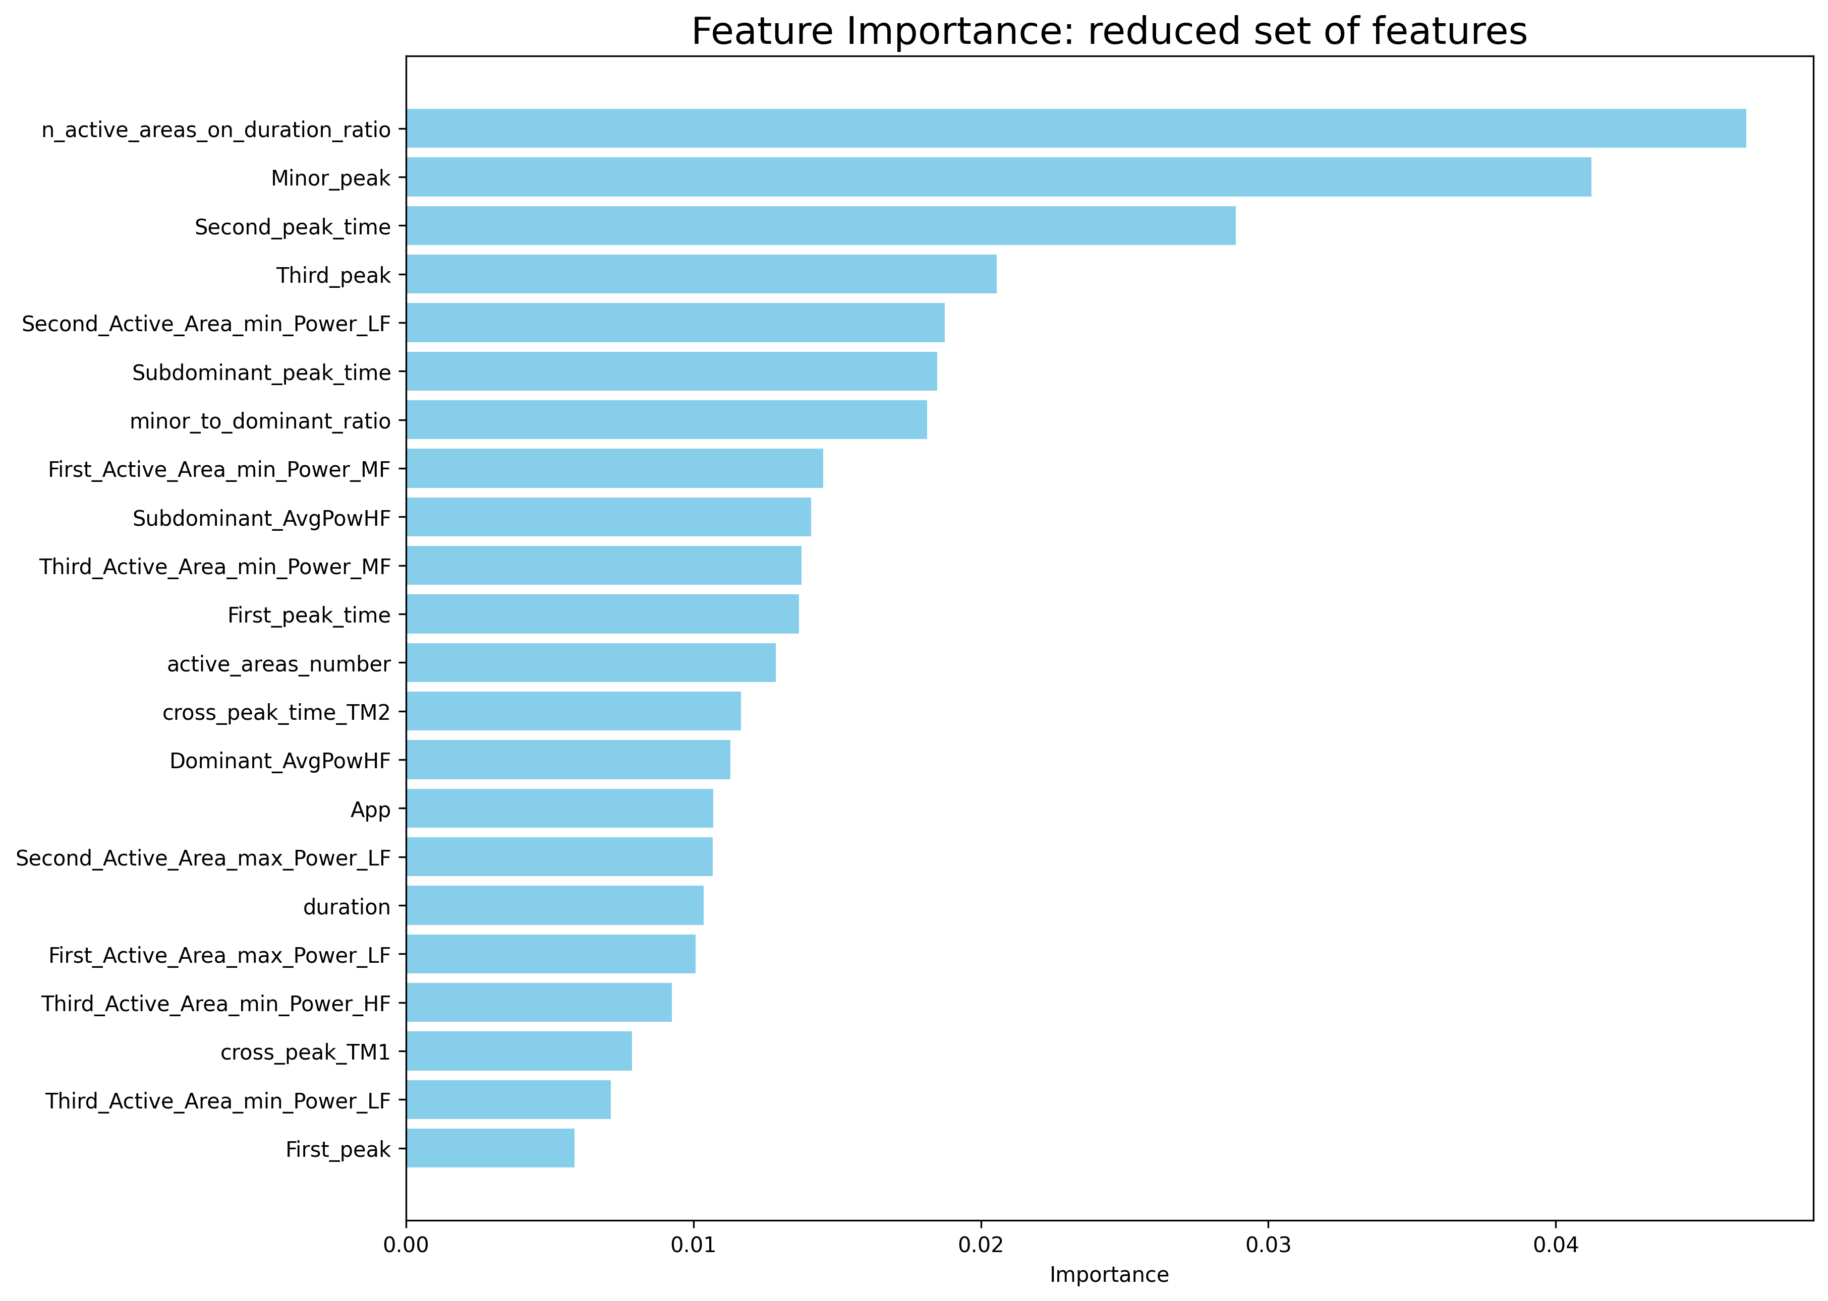
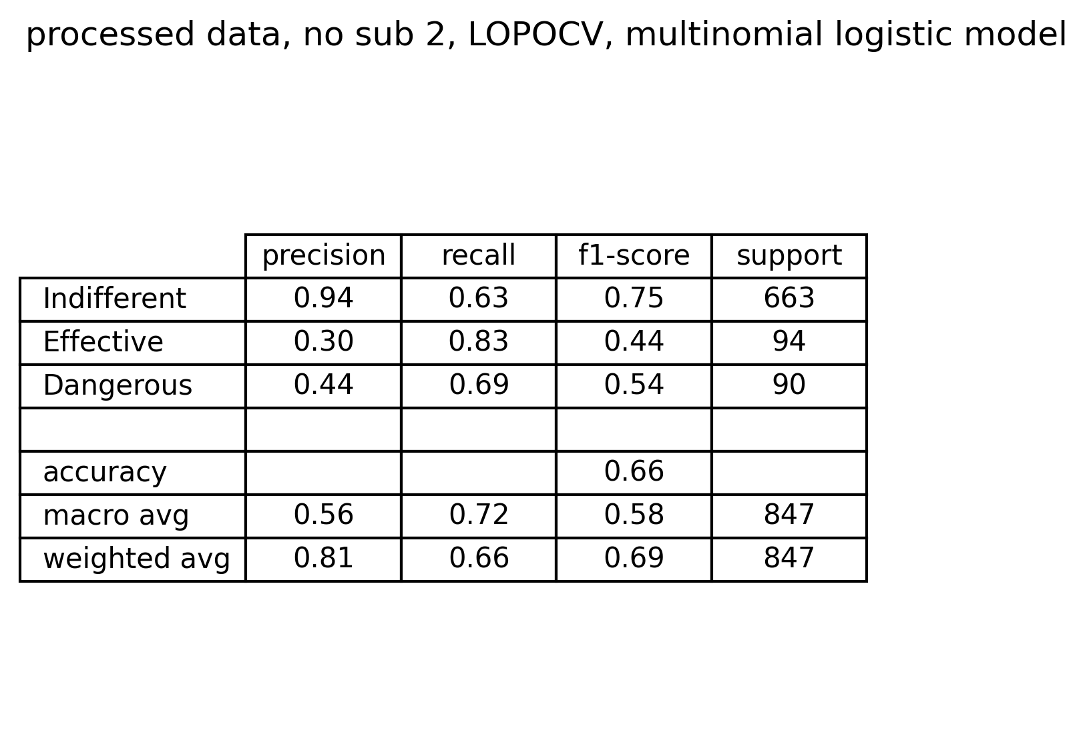
MLR classifier – optimal subset of features
Multinomial classification
1000 maximum iterations
Comments on confusion matrix and metrics:
Despite the good number of effective and dangerous signals correctly identified, there are:
8 dangerous signals recognized as effective (unacceptable)
175 effective signals predicted as indifferent (as done by the knowledge-based classifier)
71 dangerous signals recognized as indifferent (acceptable)
20 indifferent signals recognized as dangerous (risky)

Slide 23
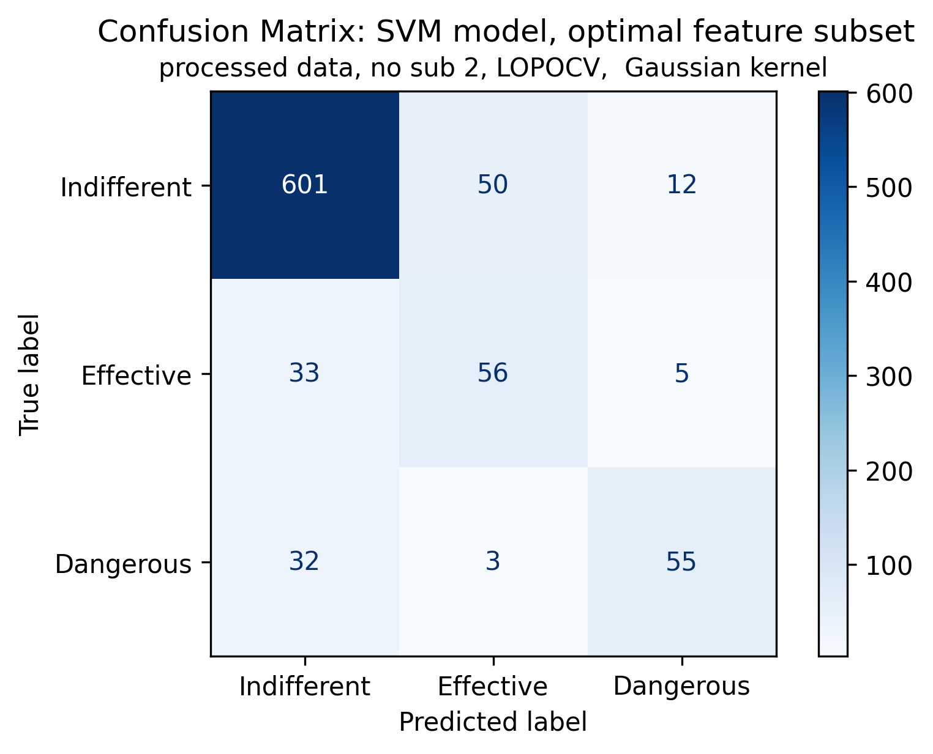
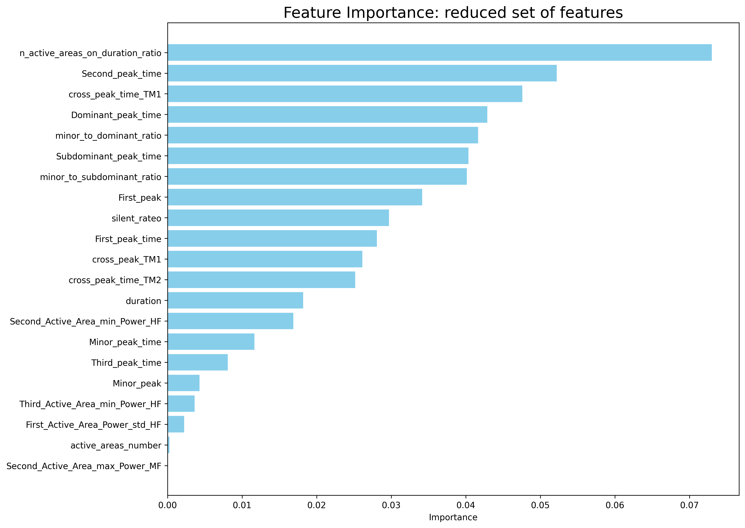
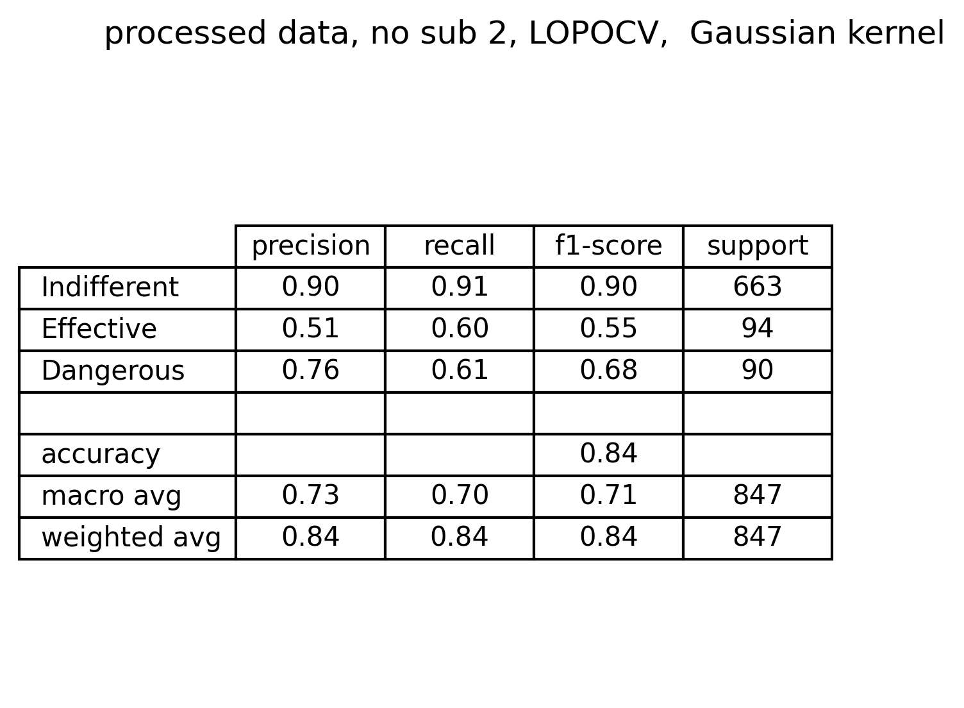
SVM classifier – optimal subset of features
Gaussian kernel
C value tuned on f1-score
Comments on confusion matrix and metrics:
Performance overall improves:
Highest f1-score levels
Still a considerable number of misclassified signals into each class
Lowest number of dangerous signals classified as effective

Slide 24
Model comparison: performance
Knowledge based
Decision Tree
Multinomial Logistic Regression
Support Vector Machine
Simple and completely explainable
Unsatisfactory performances overall
Simple and completely explainable
Improves KB performance, but there are still too many signals misclassified
Simple, explainable and probabilistic
Performs similarly to KB classifier, but metrics improves for effective and dangerous
Capture nonlinear relationships between features
Hardly explainable
Best performances overall

Slide 25
Model comparison: feature importance
Decision Tree
Multinomial Logistic Regression
Support Vector Machine
Envelope Features
Most common features
Number of active areas on total duration of active portion
Second peak time
Cross correlation peak value for TM1
Cross correlation peak time for TM2
Subdominant peak time
First peak time
Duration of active portion
Minor peak to dominant peak ratio
Morphological features
Envelope and morphological features
STFT features
Other features

Slide 26
Outline
Problem statement: recap
Feature extraction
Envelope features
Template matching features
Short time Fourier transformation features
Classification
Feature correlation analysis
Knowledge based approach
Machine learning approach: tree - MLR - SVM
Best model evaluation
Conclusions

Slide 27
Conclusions
Feature extraction pipeline defines four families of features:
Envelope features (active areas of the signal): These feature are the most important according to the feature importance of the models
Template matching (signal morphology.): These features cover a considerable role in classification
STFT features (time-frequency behavior): These features does not have a considerable impact on classification.
Literature inspired features (signal amplitude and fragmentation): these have the lowest impact on the classification
Classification phase led to the following conclusions:
Knowledge-based classifier is not sufficient to address properly the problem of classification
MLR model, due to knowledge-based inherit linearity, does not improve considerably results obtained with the knowledge based classifier
Tree classifier outperforms the performances of both previous models because can capture more deeper relationships between features
SVM classifier, despite its complexity and lower explainability, reaches the highest performances, even in terms of dangerousness of misclassification errors

